Slide 1
Grabhorn Park Advisory Committee
Road and pool workgroup
May 20,2021

Slide 2
Goal
Understand the needs and wants of the community as they relate to the pool and the road, through gathering the best available data on best practices, use demands, and community feedback. Share this data set back with the broader GPAHC so that information can be weighed against the range of use and needs being explored by the other workgroups.

Slide 3
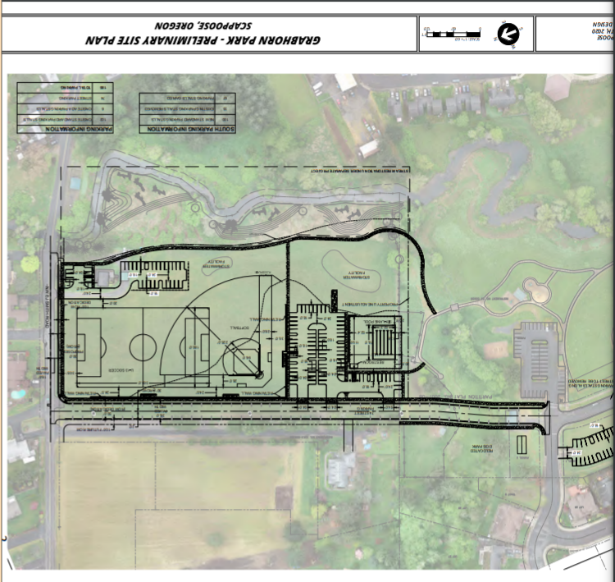
Road considerations
Costs
Options
Community input
Best practices in parks

Slide 4
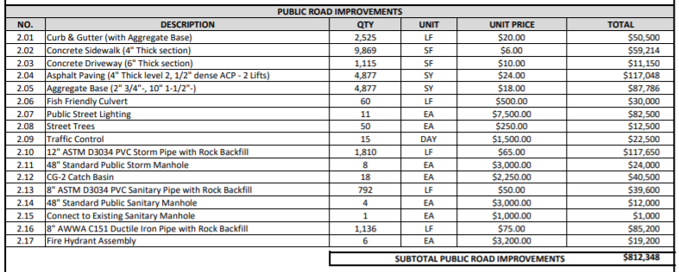
Costs – Estimates from Nov 5, 2020 conceptual plan

Slide 5
Road options
Two lane road with speed reduction method (speed bumps, raised pedestrian crossings, etc)
One lane road with traffic prevention (bollards, locked gate
One lane gravel road with traffic prevention
Action item:
Connect with police and fire department (Kim to reach out and schedule call with the group week of 5/17)
Ask police why the speed check was in the park? Function?
Has a study been done to determine what parking needs might be (ie, how many spots are needed for different intended uses)?

Slide 6
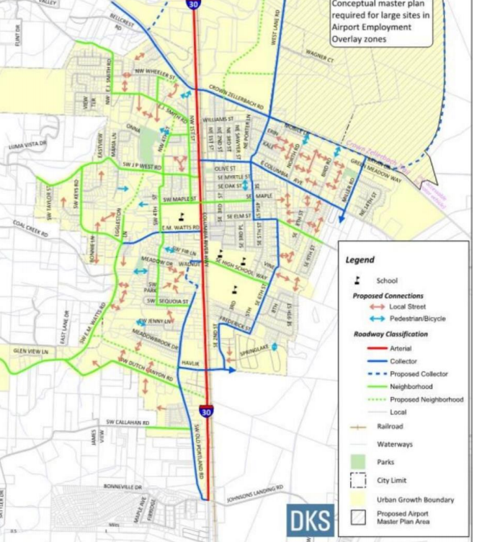
Alternatives Local Connections Study
Action items:
ID priorities from 2016 report relative to new report. Why has EJ smith connection become a priority when it wasn’t in the transportation plan of 2016?
How does this work fit into the 2016 master plan for other land acquisition?
Take on for next cycle (week of June 14th)

Slide 7
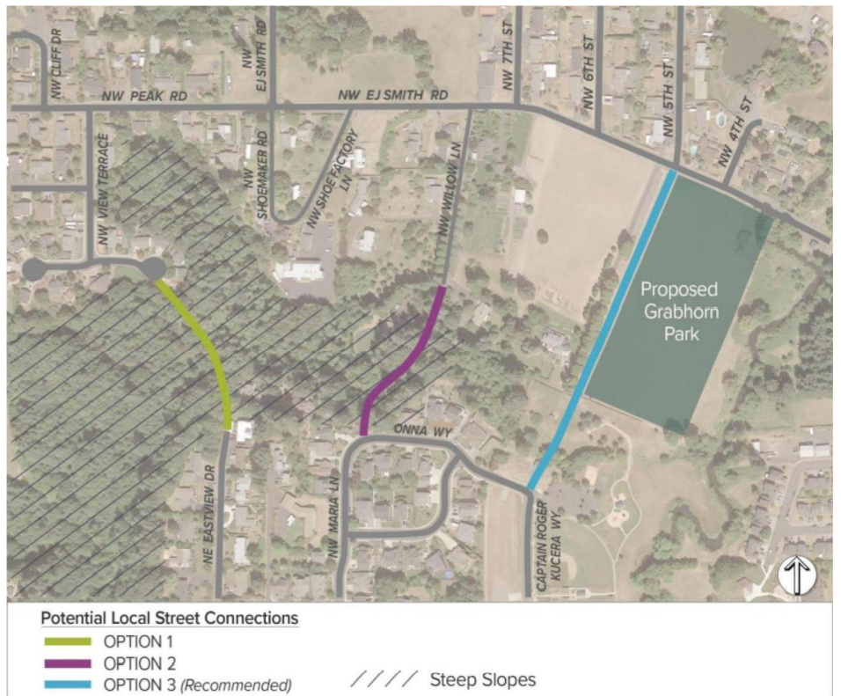
Connection alternatives

Slide 8
Best practices
https://www.nrpa.org/our-work/partnerships/initiatives/safe-routes-to-parks/
Park Development Best Practices Staff Report

Slide 9
Community input
Action item:
Create quantitative data from qualitative information (Paul to take first pass by 5/31)
Measure:
Support v. opposition for the road

Slide 10
Traffic trends in parks
Other examples:
Forest Grove, Thatcher Park
Action Items:
Gather more examples
Review Isaacs resources on park design best practices
https://bikeportland.org/2020/03/25/city-of-portland-bans-driving-in-10-parks-312918

Slide 11
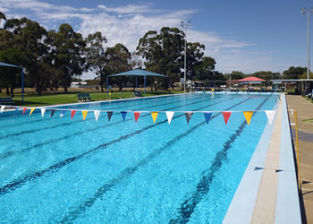
Pool Considerations
Funding
Alternatives
Community input

Slide 12
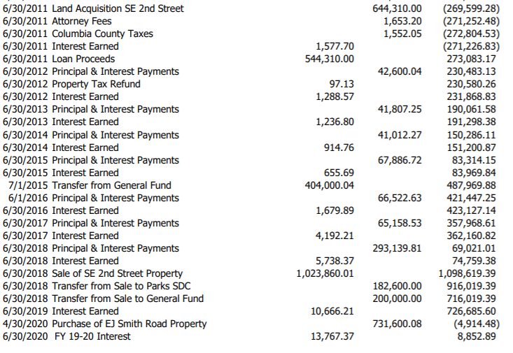
Pool Fund expenditures
https://www.ci.scappoose.or.us/sites/default/files/fileattachments/community/page/19580/revenues_and_expenditures_all_pool_funds_as_of_december_22_2020.pdf

Slide 13
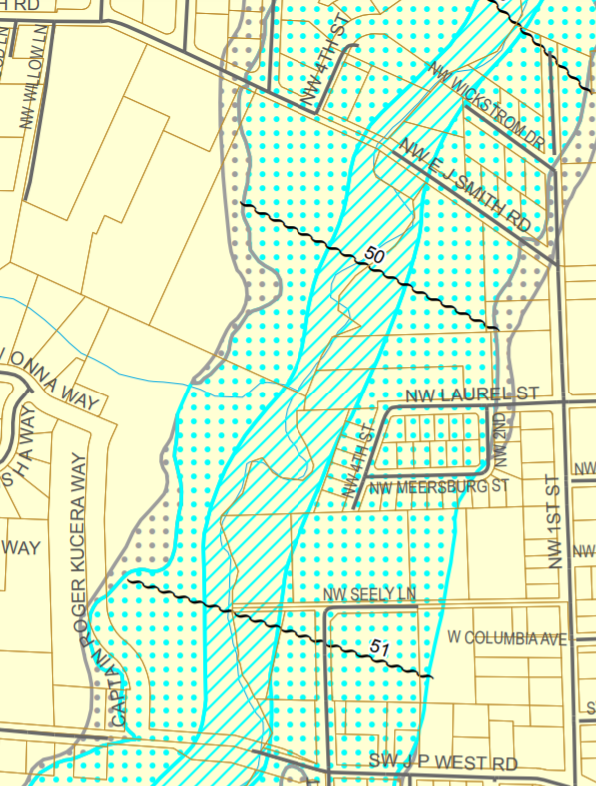
Flood Plain (4/2021)
https://www.ci.scappoose.or.us/sites/default/files/fileattachments/planning/page/982/floodplain_large.pdf

Slide 14
Funding
Based on pools recently built in other Oregon cities, an outdoor pool is estimated to cost $3,500,000. An indoor pool is estimated to cost $11,000,000. Operating a public pool would cost approximately $500,000 each year.
Bob Casswell Pool Fund - Privately held fund created in the 1970's through donations and fundraising. Current Balance: $33,948.30
Swim Council Pool Fund - Privately held fund created in conjunction with the Swim Council. Current Balance: $14,382.33
City of Scappoose Pool Fund - Created in 1999 with General Fund money. Current Balance: $8,852.89
Action item:
- Determine how/when these funds can be used
- What are the legal obligations to use the funds for a pool (Isacc and Huel to work on? City lawyer to join a meeting?)
https://www.ci.scappoose.or.us/community/page/pool-cost-and-pool-fund-information

Slide 15
Alternatives
Splash pad or other aquatic water feature
Potentially as a expensive as a pool (needs filter systems, can be as dangerous as a pool)
Serves population up to 2nd grade
Action item:
Learn to learn more about water feature in Heritage Park. To be discussed on 5/17 at City Council. (Kim to send a link workgroup).
Get pricing for splash pads (Paul to gather some info, Isacc and Huel gather public expense numbers?
Seek partnership, PPC?
County-wide project?

Slide 16
Funding options
Property taxes (city survey, results due July)
Grants
Will make a recommendation that City Council put together a group in the future to look at funding options for a pool in the future.

Slide 17
Action items to be completed by 5/28
Kim set up meetings with fire and police
Everyone gather examples of thru traffic trends in parks and review Isaac's resources on park design best practices
Kim reach out Huell to investigate legal obligations of pool funds
Everyone who can listen into the City council discussion on 5/17 re: the water feature at Heritage Park
Everyone, research pricing info for splash pads
Kim ask Huell and Isaac about splash pad pricing
Kim to ask Huell if there is a study to determine what parking needs there might be (ie, how many spots are needed for different intended uses)

