Slide 1
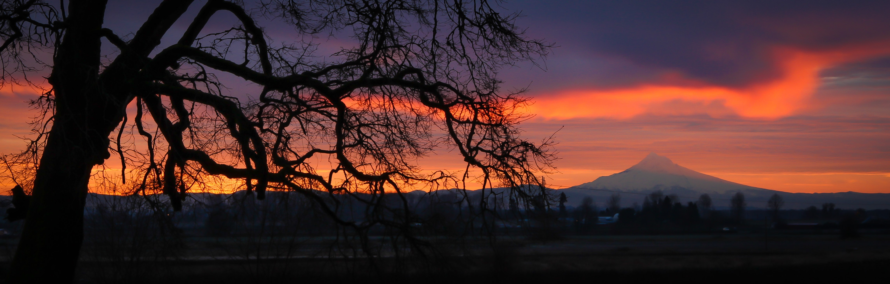
2017 Annual Town Meeting
February 11th 2017
8:30AM - 12:00PM

Slide 2

City Motto and Vision Statement
Pick up a copy of the Vision Statement in the back and…
Pick up a motto sheet in the back and submit your idea!
  Voting will be done online next week

Slide 3
How old are you?
Less than 18
18 – 25
26 – 33
34 – 41
42 – 49
50 – 57
58 – 65
66 – 73
Greater than 73

Slide 4
Do you live within Scappoose City limits?
Yes
No
Unsure

Slide 5
How long have you lived in the Scappoose area?
Less than 1 year
1 – 3 years
4 – 6 years
7 – 9 years
10 – 12 years
13 – 15 years
16 – 18 years
19 – 21 years
More than 21 years

Slide 6
In 20 years what do you see as the ideal population of Scappoose?
Same as today
10,000
13,000
16,000
I don’t know

Slide 7
How did you hear about the ATM?
Signs along Hwy 30
The Spotlight newspaper
City newsletter
Flyers around town
Word of mouth
The City’s website
Social media (i.e. Facebook etc. )
Other

Slide 8
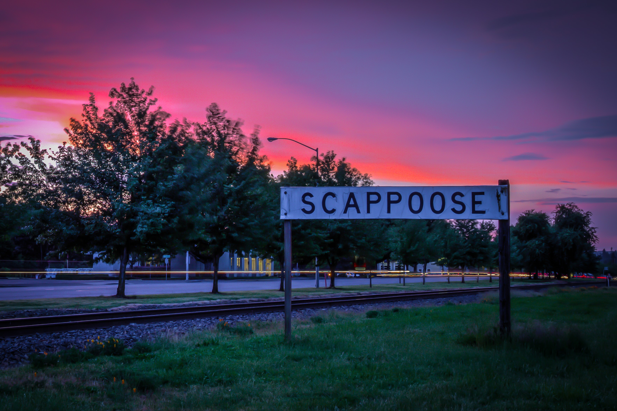
Scappoose Housing Needs Analysis (HNA)
Notes:
Question: What housing issues are you most concerned about in Scappoose?
Answers: Costs of homeownership
Rent costs
Potential for fast residential development

Slide 9
What housing issue concerns you the most in Scappoose?
Cost of homeownership
Cost of rent
Housing availability
Too much growth too quickly
All of the above
Other

Slide 10
Why is Scappoose doing a HNA?
How much and what type of housing is needed?
Does Scappoose have enough buildable residential land?
What policy changes should the City consider making to our residential development code?
Notes:
Removed:
How much and what types of land will be needed for housing?
What development patterns make sense?

Slide 11
What is a Housing Needs Analysis?
Demand is a function of population growth
  Population
  Demographics
    Age
    Household composition
  Income
  Housing costs
  Housing affordability
Supply is a function of housing stock and land base
  Housing stock and characteristics
  Vacant, partially vacant, and redevelopable land
Notes:
Should you do a graph rather than talk about it?

Slide 12
How do we determine buildable land?
First determine if all residential land is either
  Vacant
  Partially Vacant
  Developed
  Then remove constrained land and already developed land
  Wetlands
  100 Year Floodplain
  Riparian Corridors
  Slopes > 25%

Slide 14
Buildable Residential Land in Scappoose:
Land Type | Availability
General Residential | 12 Acres
Suburban Residential | 261 Acres
Manufactured Home | 12 Acres
Commercial (Only a portion will be available for residential development) | 42 Acres
Total | 327 Acres

Slide 16
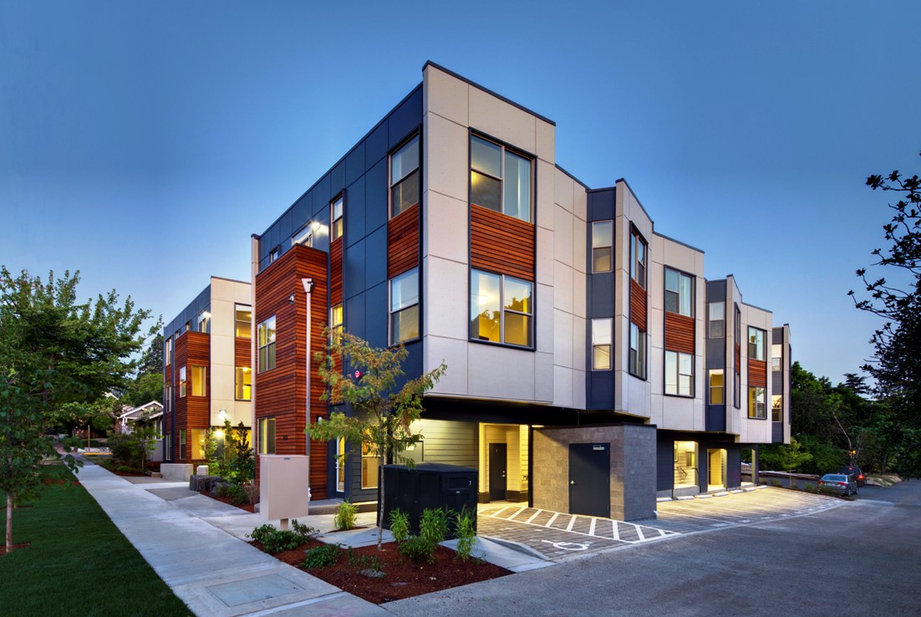
Does Scappoose have enough residential land to accommodate growth?
We will not know until the analysis is finished
But the City only has 2 acres of vacant land zoned A-1, which is for multifamily housing
Notes:
Question:
If the City does not have enough land for multifamily, where would you like to see more multifamily allowed?
Answers: I’ll need your help in developing clear answers. Some answers may include in Downtown, along certain portions of Highway 30 (or a bit off of the Highway).
Ben: I moved this to after the next slide

Slide 17
What if Scappoose does not have enough land to accommodate growth?
First we address possible policy changes:
Allow smaller residential lots
Allow a wider range of multifamily housing in single-family zones
Allow higher density multifamily housing
Redesignate or re-zone land for housing
Increase height limits in high density zones
We need your help deciding on policy changes…

Slide 18
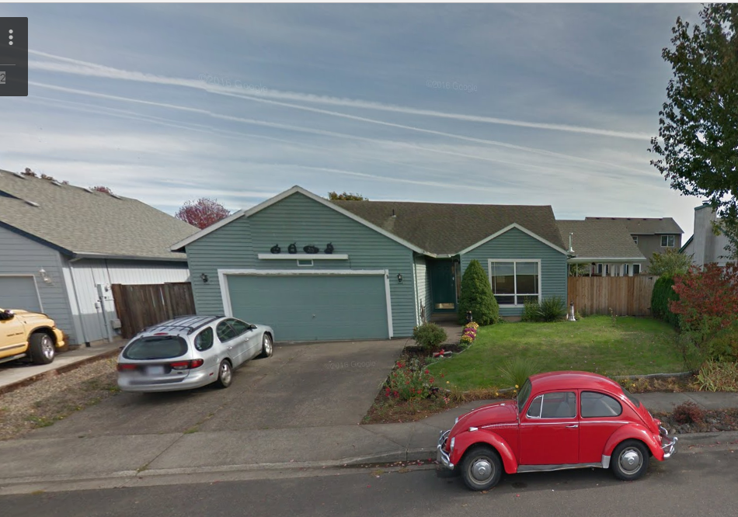
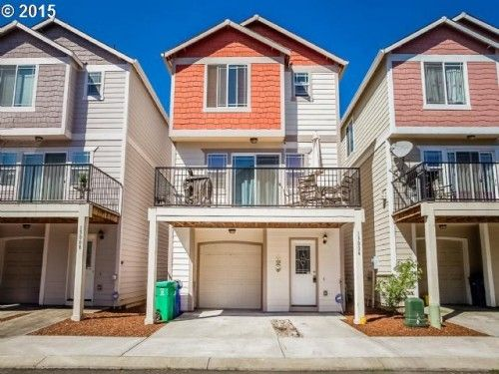
Low density lot size policy…
The City currently allows 7,500 square foot lots (1/5 of an acre) in our low density zoning district and 6,000 square foot lots in our moderate density zoning district (think Dutch Canyon Estates) for single-family detached housing.
6,500 square feet
3,000 square feet
Notes:
Question: The City currently allows 7,500 square foot lots in our low density zoning district and 6,000 square foot lots in our moderate density zoning district for single-family detached housing. If Scappoose allows smaller single-family lots, what is the smallest lot size the City should allow?
Answers:
5,000 square foot lots
4,000 square foot lots
3,000 square foot lots
This City should not allow smaller single-family lots.

Slide 19
If Scappoose allows smaller single-family lots, what is the smallest lot size the City should allow?
5,000 square feet (smaller than Dutch Canyon Estates)
4,000 square feet
3,000 square feet
The city should not allow smaller single family lots

Slide 20
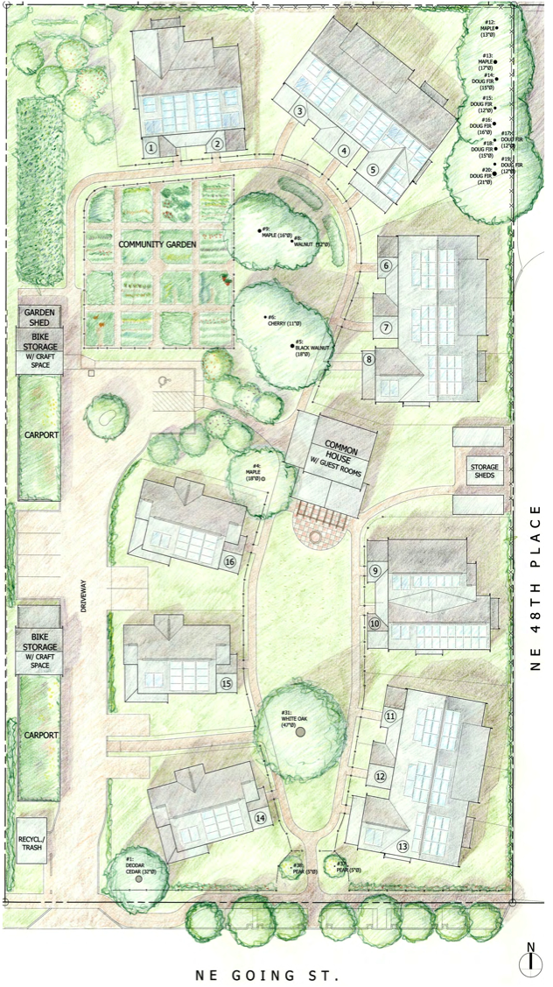
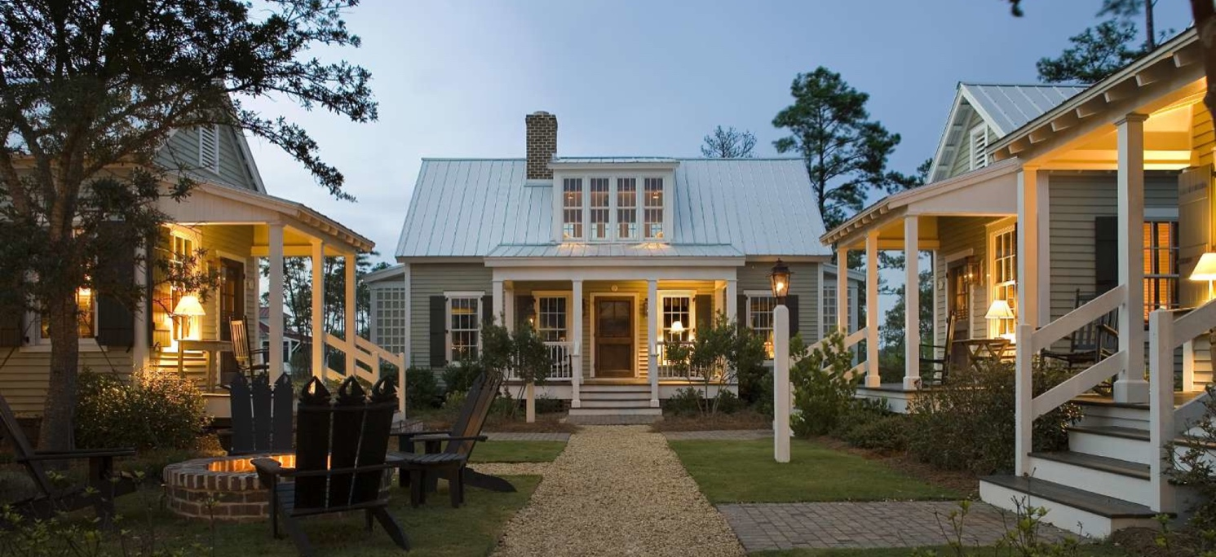
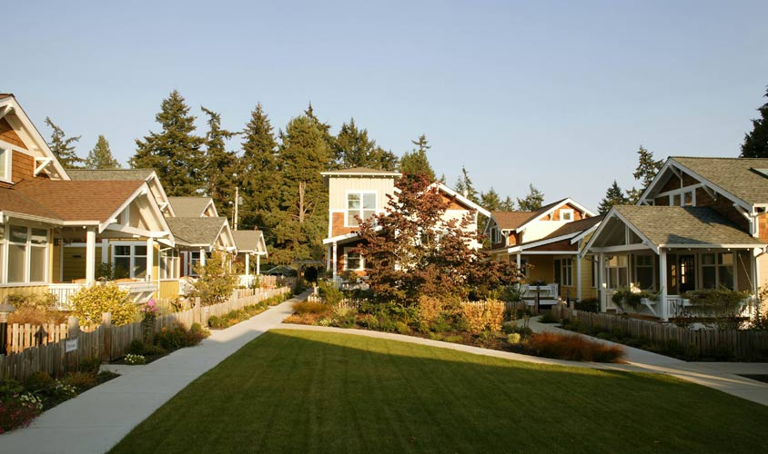
Housing Types: Cottage Clusters
Typically 600 to 1,000 square foot houses on small lots, often with shared open space
Notes:
Question: Do you think the City should consider allowing cottage cluster housing in selected areas?
Answers:
Yes
No
I am not sure

Slide 21
Should the City allow Cottage Cluster type housing in certain areas?
Yes
No
I’m not sure

Slide 22
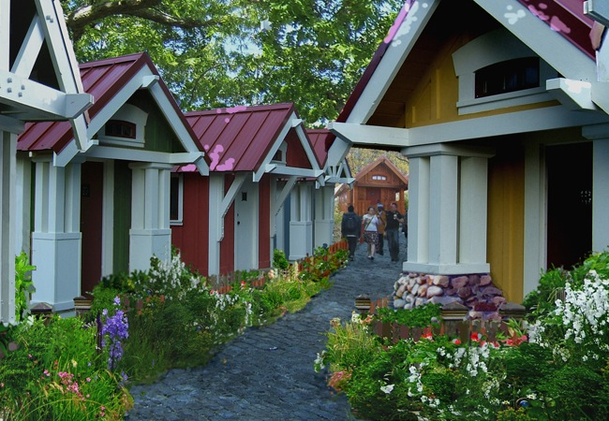
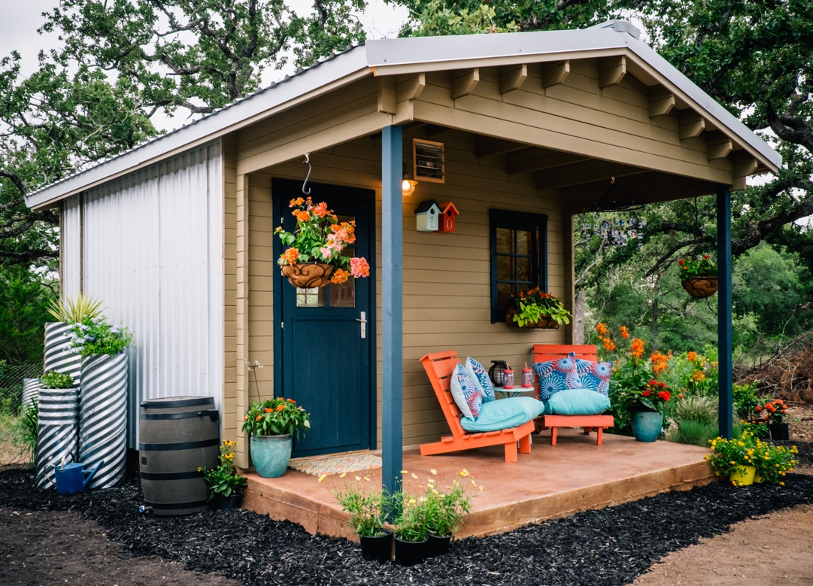
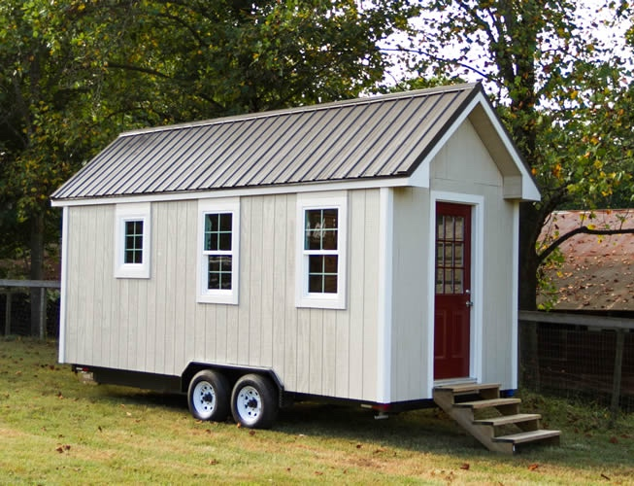
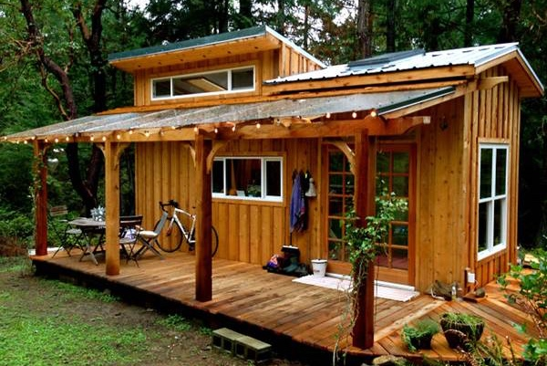
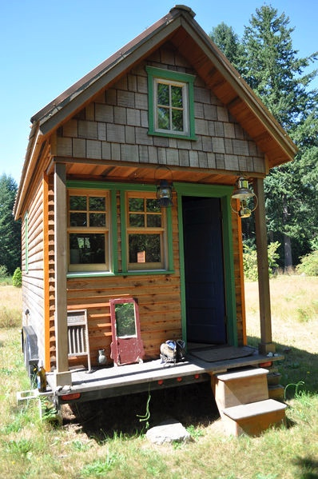
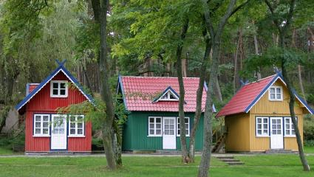
Housing Types: Tiny Houses
Typically smaller than 500 square foot on wheels or a foundation
Notes:
Question: Do you think the City should consider allowing tiny houses in selected areas?
Answers:
Yes
No
I am not sure

Slide 23
Should the City allow Tiny Houses in selected areas?
Yes
Yes, but only on single lots
Yes, but only in tiny home communities
No
I’m not sure

Slide 24
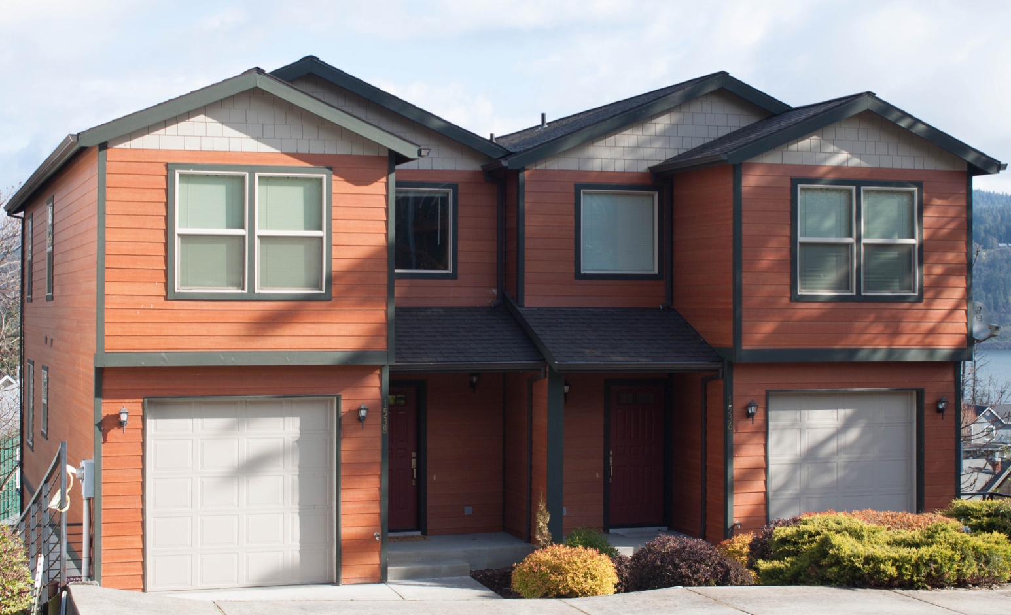
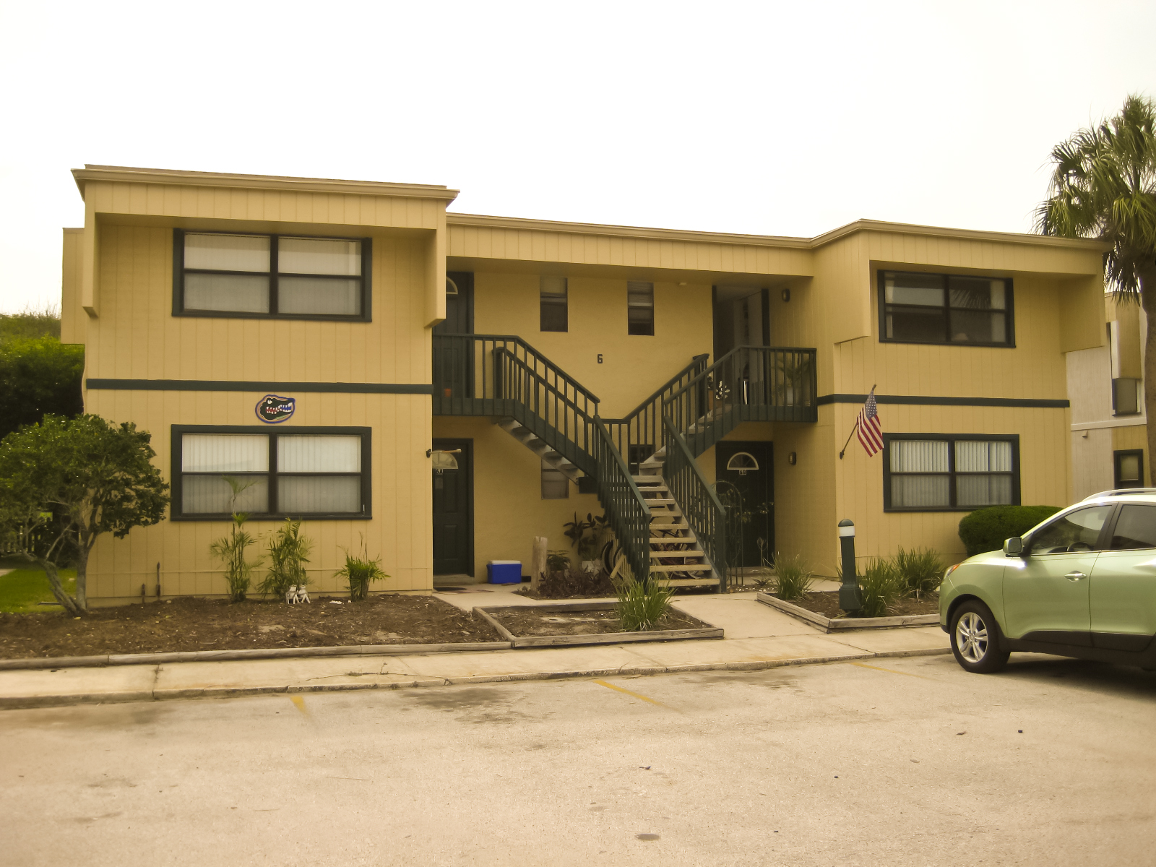
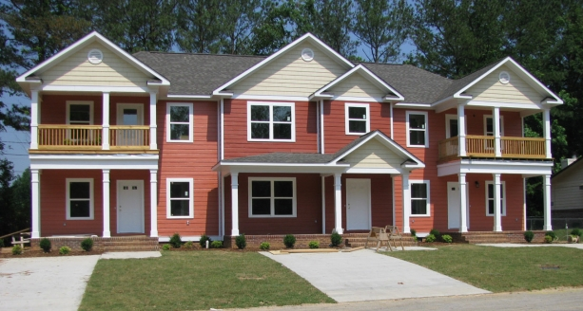
Housing Types: Duplexes, Tri-Plex, and 4-Plex
Duplex
Tri-Plex
4-Plex
Notes:
Question: Should the City allow duplexes in the R-1 zone (low density zone) ( west side of town above veterans park)?
Answers:
Yes, on any lot where a single-family detached house is allowed
Yes, but only on corner lots
No

Slide 25
Should the City allow multiplexes in the low density zone?
Yes
Yes, but only on corner lots
No

Slide 26
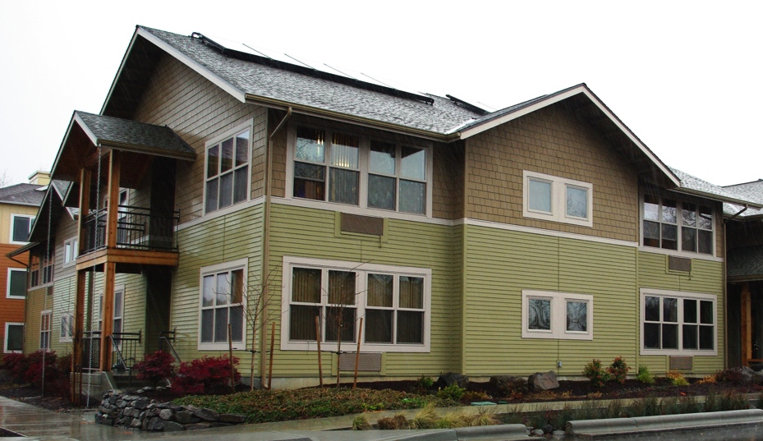
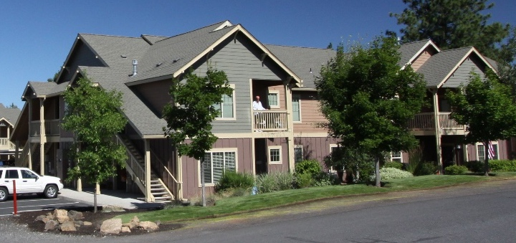
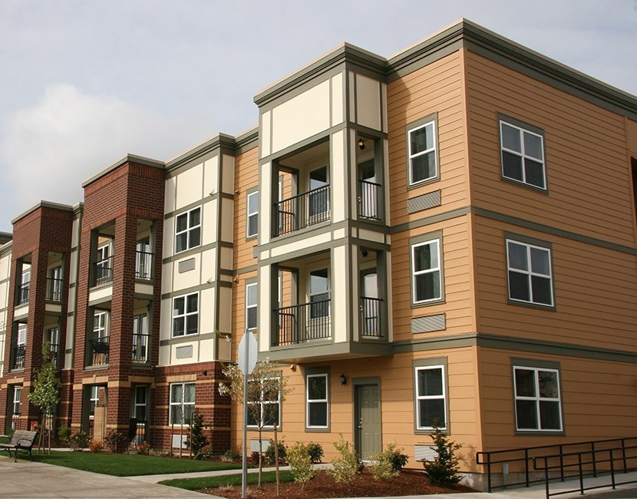
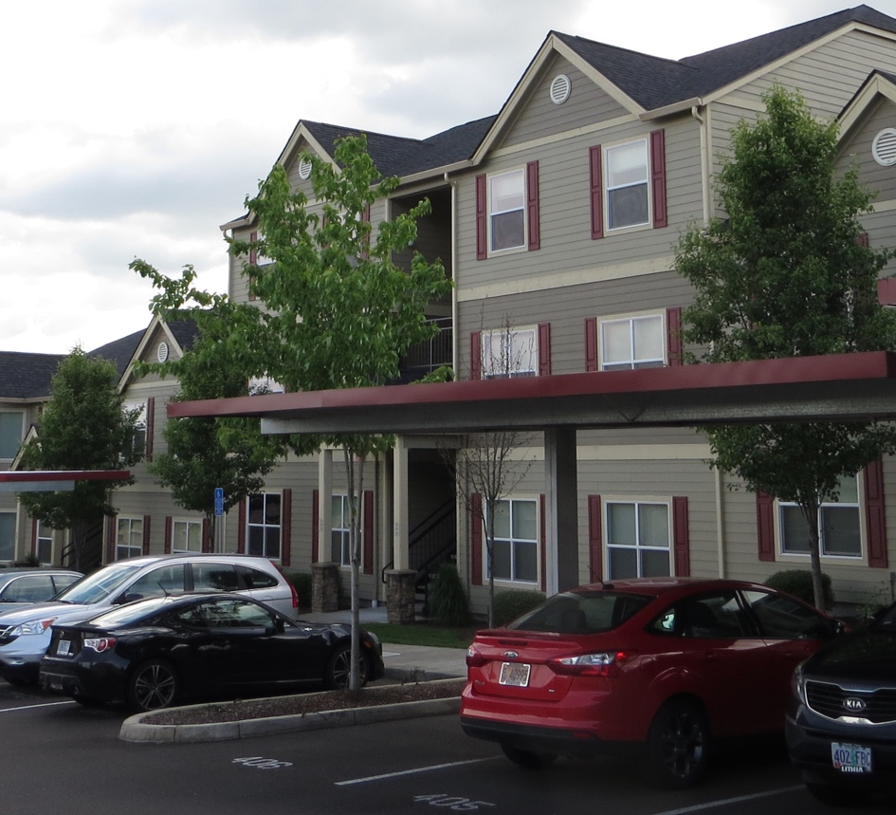
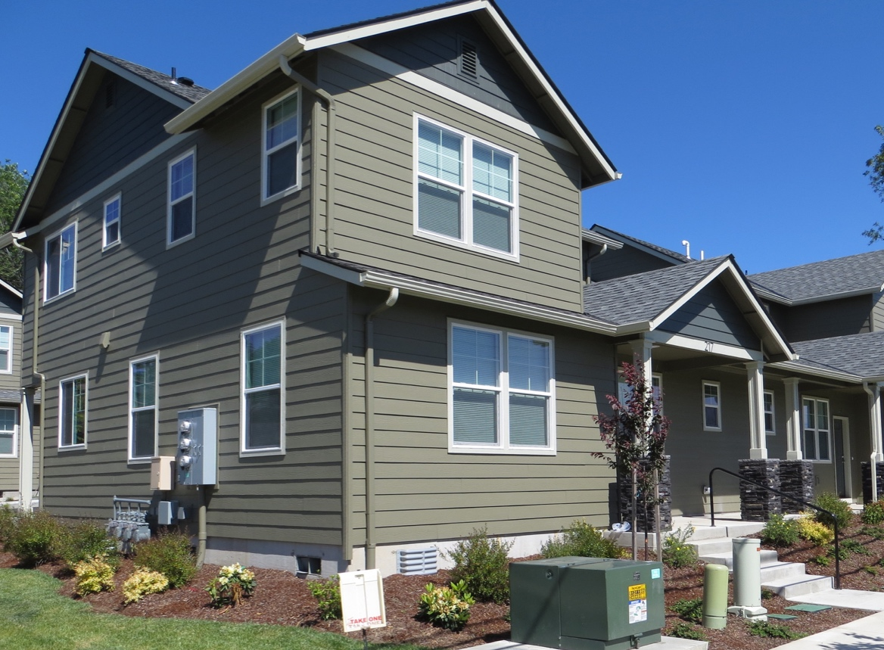
Housing Types: Apartment Complexes
The City will be making changes to its development code for apartment buildings.
Notes:
What is this question?
Currently the city’s development code only allows 8 units per apartment building which acts as a barrier to development (what does mean and what would it look like?) . If the city allows more units per building, how many should we allow?

Slide 27
What issues concern you most about apartment complexes in Scappoose?
Design of the buildings
Parking
Proximity to single family homes
The potential for too many apartment complexes in one area
All of the above
None of the above

Slide 28
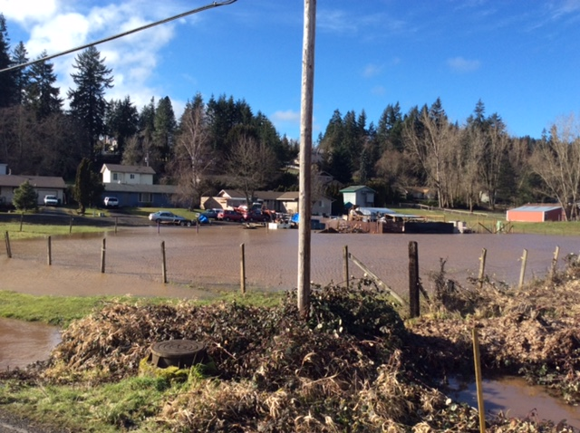
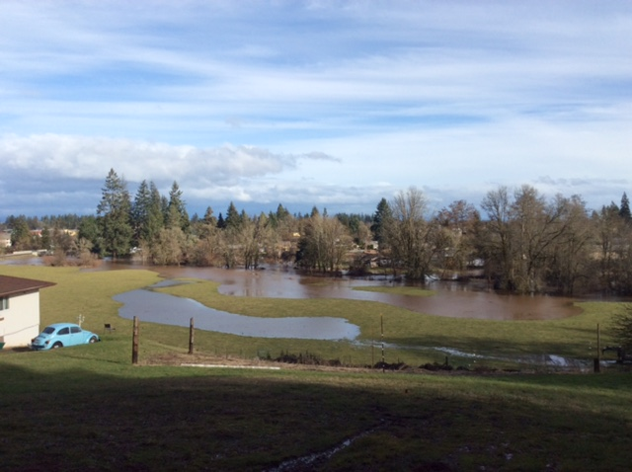
Development Near Floodplains
The City deducted 214.1 acres from our buildable land inventory since the land was within the regulated 100 year floodplain.
Notes:
Why is this here?

Slide 29
Do you think the City should allow for increased housing density on a parcel affected by the floodplain if the developer agrees to dedicate the land area within the floodplain to the City as public open space?
Yes
No
I’m not sure

Slide 30
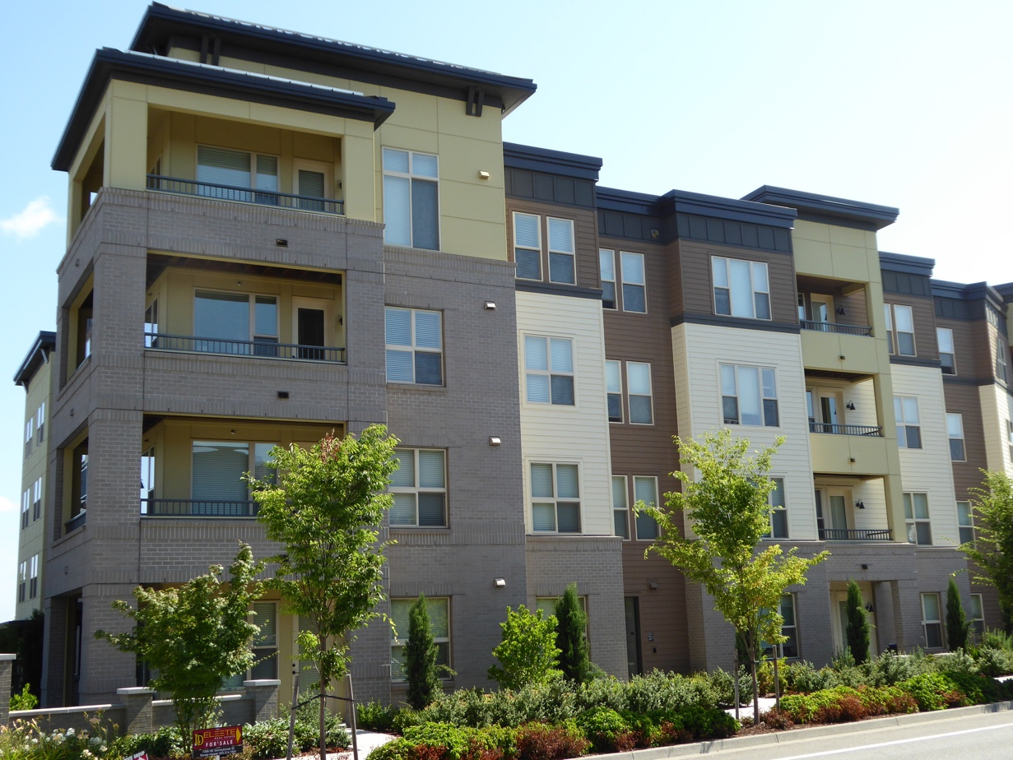
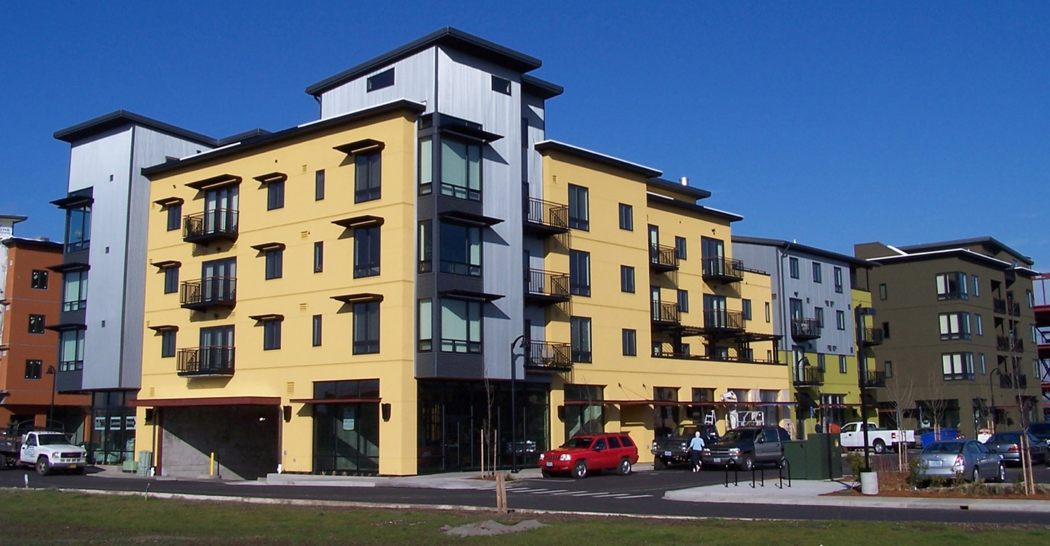
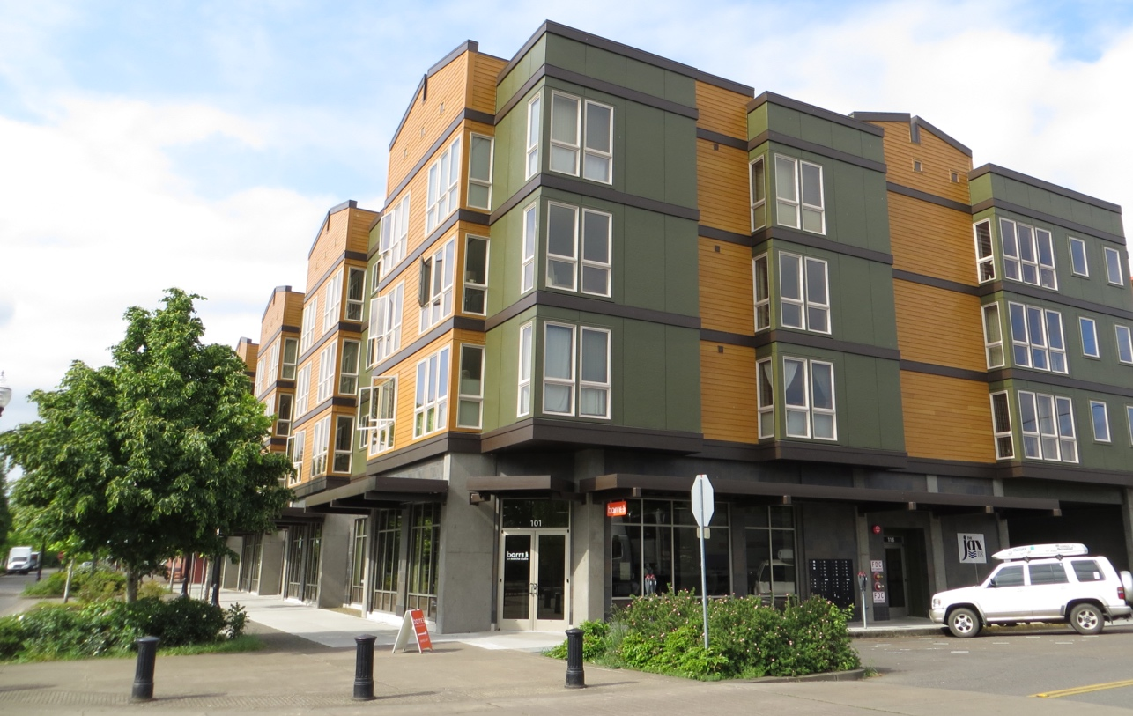
Housing Types: Taller Apartment Buildings and Mixed Use Buildings
The City currently limits residential building heights to 35 feet and commercial building heights (Fred Meyer, Bi Mart etc.) to 50 feet in the commercial zones (about as tall as the candle).
Notes:
Question: The City currently limits residential and commercial building heights in the A-1 zone (high density) and EC (Expanded Commercial – Fred Meyer, Bi Mart etc.) zone to 50 feet. Should the City allow buildings up to 60 feet to increase density?
Answers:
Yes
No
The City should allow taller buildings.
Question: Should the only residential uses allowed in the commercial zone be apartments above store fronts? (Talk to Beth)
Answers:
Yes
No
I am not sure

Slide 31
Should the City allow buildings up to 60 feet (about 5 stories) in the commercial zone?
Yes
Yes, but only for mixed use buildings
No

Slide 32
What types of residential development should the City allow in commercial zones?
Allow residential uses that meet the high density residential zoning requirements (this is what our code currently allows)
Allow residential uses if they are above commercial space on the first floor (aka mixed use buildings)
Both A and B

Slide 33
What if policy changes STILL leave us without a 20 year supply of land?
Housing Needs Analysis
Is there enough land to accommodate growth?
Monitor and reexamine housing need
If there are housing needs that cannot be met with current policies
Expand the UGB
Identify policies to increase land use
efficiency
Adopt the analysis
If housing needs cannot be met within the UGB
Conduct a UGB alternatives analysis
Determines where to expand
Notes:
Ben: When does the idea of a UGB expansion get introduced?

Slide 34
There will be several more opportunities to provide input on housing policy changes.
Please watch the City newsletter and City website for upcoming work sessions to discuss housing policy changes.
We welcome your input.
http://www.ci.scappoose.or.us/

Slide 35
10 minute break
Restart at 10:00

Slide 36
Parks and Recreation

Slide 37
How important are parks to you when choosing where to live?
Very important
Somewhat important
Not that important
It doesn’t even cross my mind

Slide 38
Does Scappoose’s Park System meet your needs?
Yes
No

Slide 39
Benefits of Parks
Parks produce measureable economic, health, environmental and community values
2008 report TPL find seven benefits of parks:
  Property Value
  Tourism
  Direct Use
  Health
  Community Cohesion
  Clean Water
  Clean Air

Slide 40
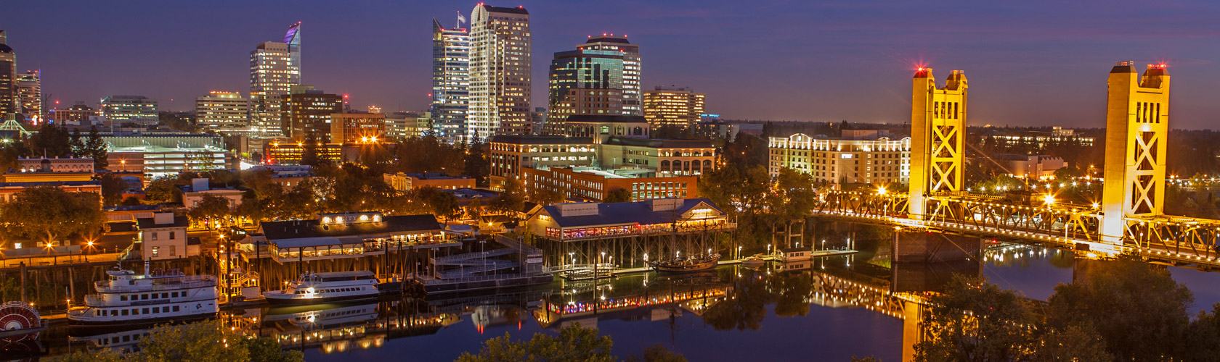
Health & Economics of Parks
Health savings from Park use for 85 largest cities in US = $3.08 Billion
Sacramento health savings from park use = ~$20 million
  $250 for people less than 65
  $500 for people 65 and over

Slide 41
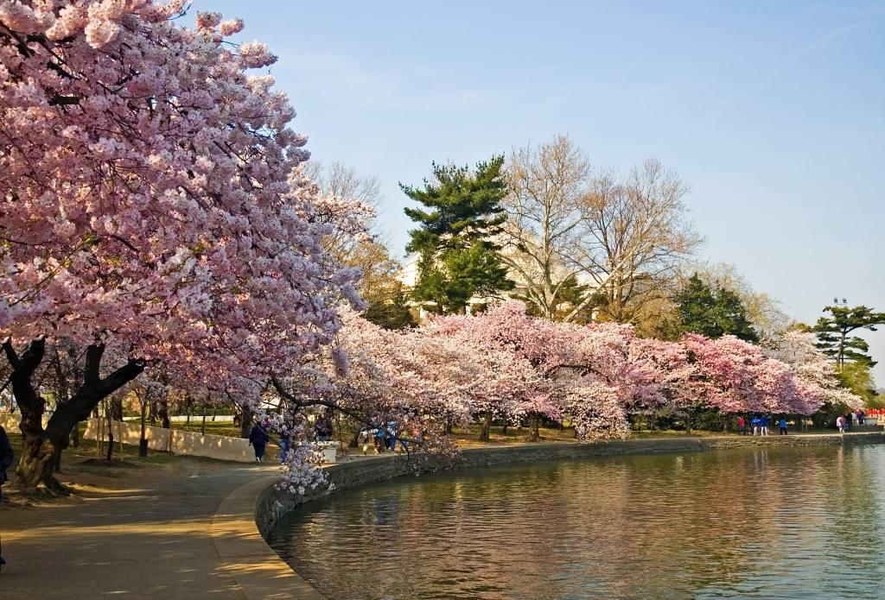
Community Services of Parks
Philadelphia parks generated:
  $8.6 million in donations and volunteer hours
  $6 million storm water retention value
Washington DC parks:
  Beautiful nationally recognized cherry trees
  Removed 244 tons CO2, NO2, O3, SPM, SO2
  ~$ 1.103 million value in pollutant removal

Slide 42
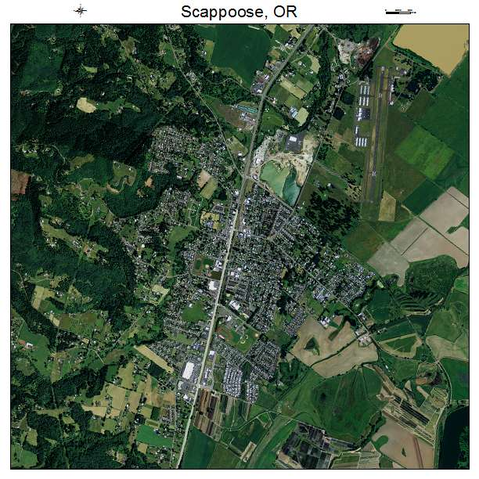
Value of Parks to Cities
Parks and Water Ways are the heart of numerous cities
  San Antonio
  Missoula
  Hood River
  Durango
  Nashville
  Boise
  Vernonia
  AND SCAPPOOSE

Slide 43
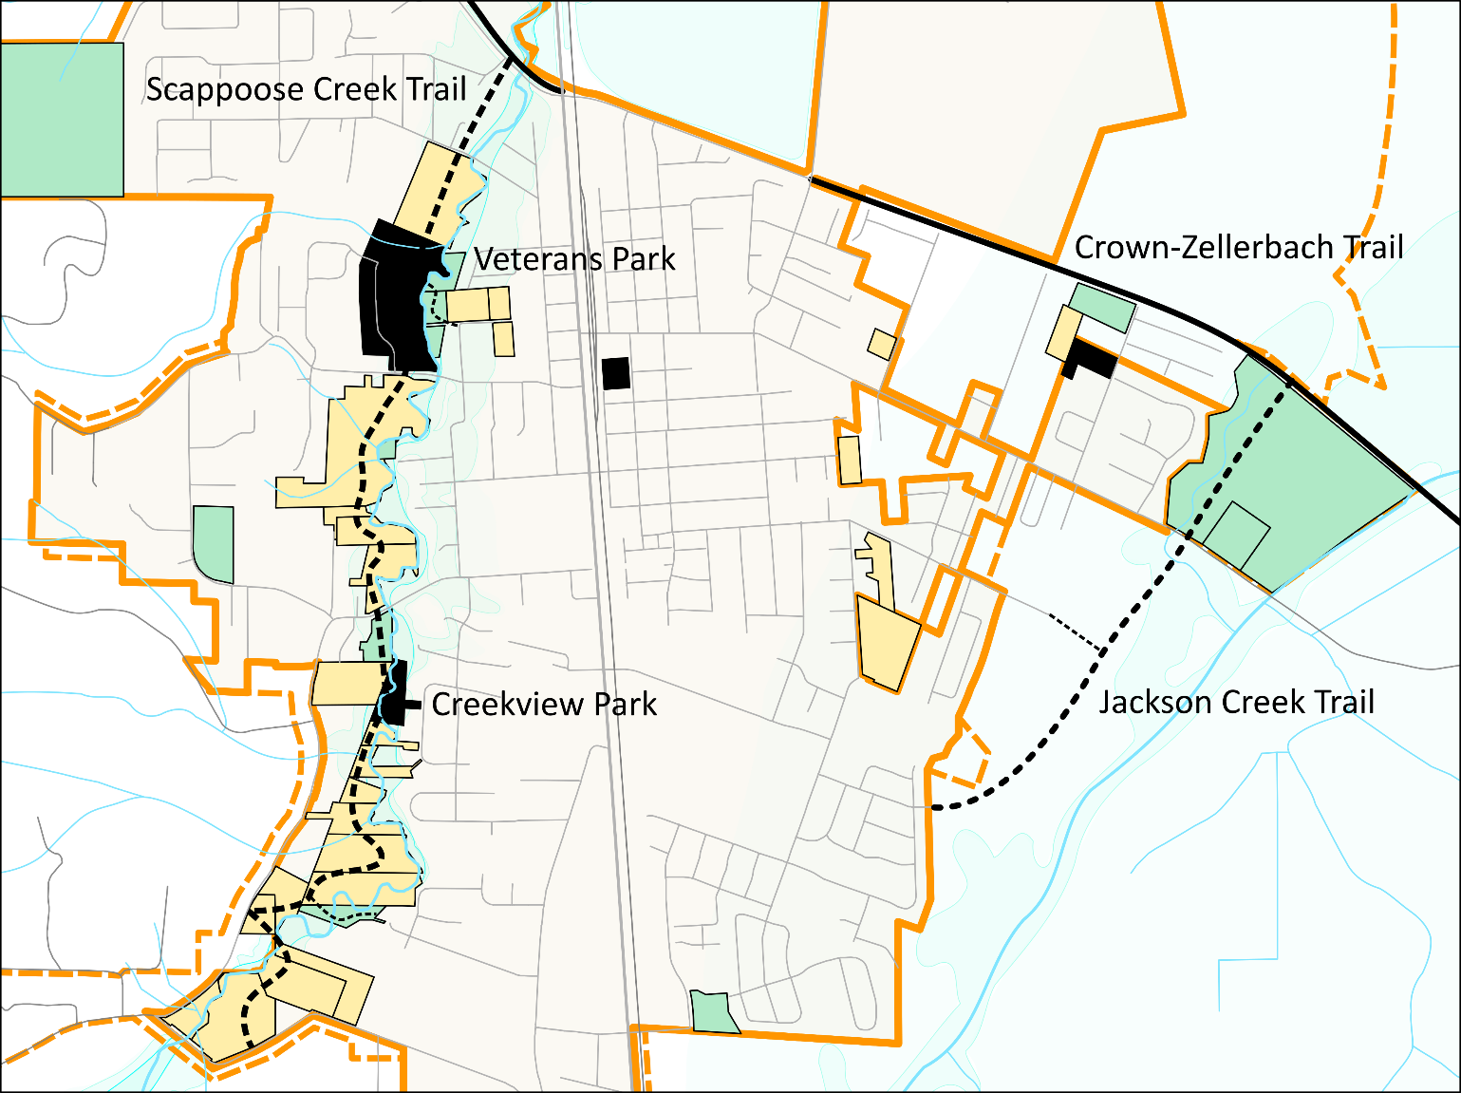
Scappoose Park Corridors

Slide 44
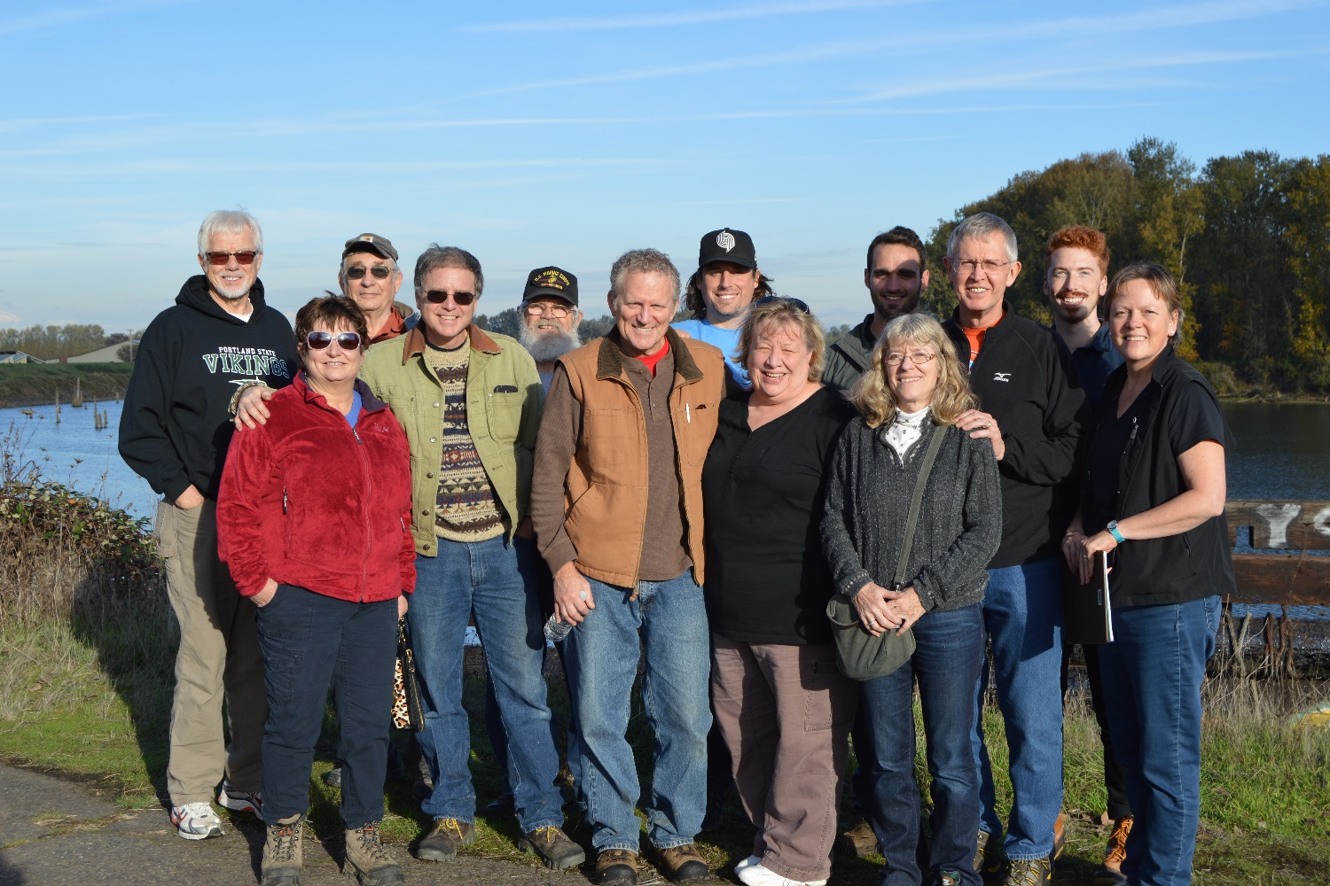
The Committee

Slide 45
Parks and Rec Committee
Formed Sept. 2015, with 1st formal meeting Oct. 2015
Meetings held 3rd Thursday of each month in City Hall
9 voting members appointed by the city
Diverse, talented mix of people
Park Master Plan last updated 1997

Slide 46
Parks and Rec Committee
Purpose of Committee
Values and Goals
Strengths and Weaknesses Analysis
Partners
Potential Funding

Slide 47
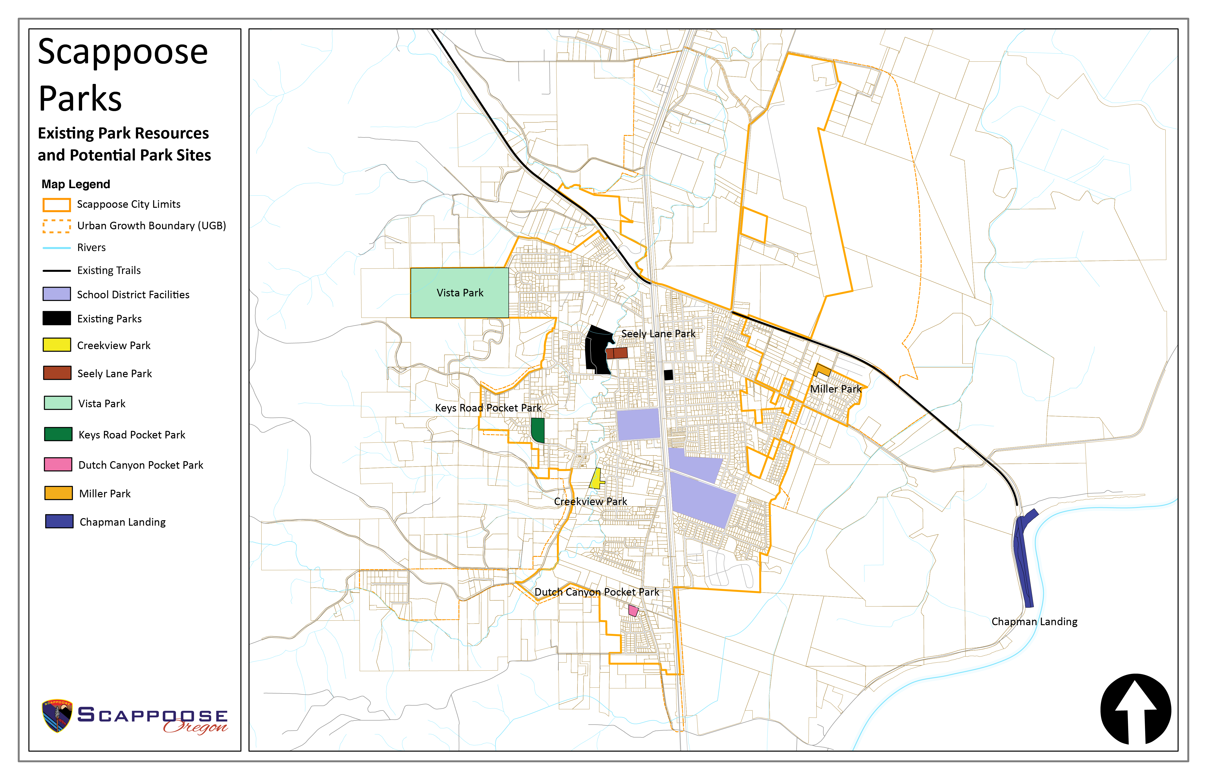
Scappoose’s Park System

Slide 48
Scappoose’s Park System

Slide 49
Scappoose’s Park System

Slide 50
Breakout Groups
Positives
Negatives
Alternatives
Parking Lot

Slide 51
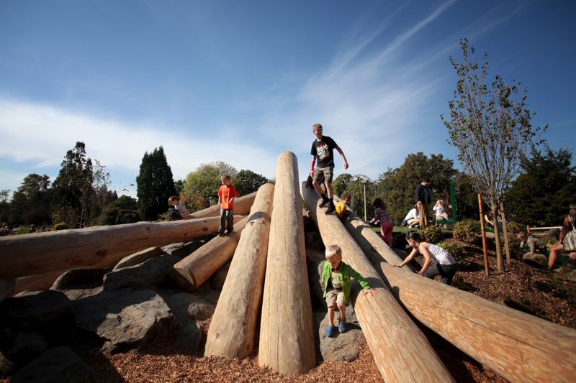
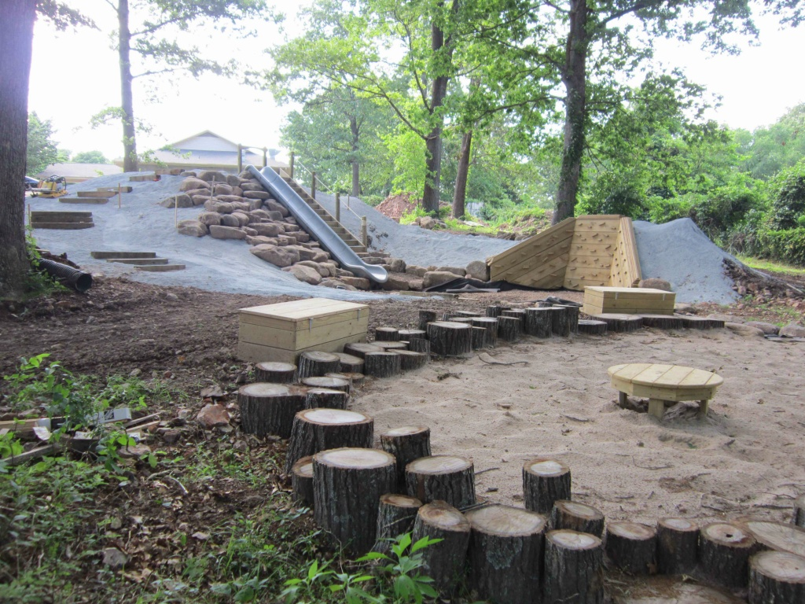
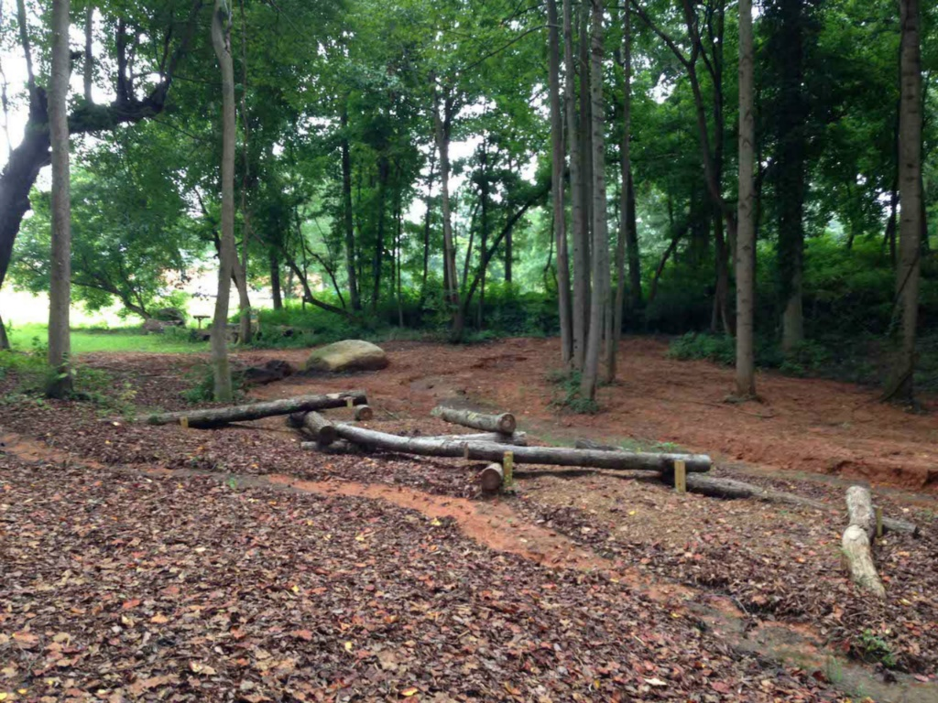
“Nature Play Area”

Slide 52
You choose where to go

Slide 53
Be done with Round 1 by 11:00
and hand out dots

Slide 54
Dot Exercise
You have 6 dots to put on the 6 bullets you agree with MOST.
Please put ONLY 1 dot per bullet.
Sit back down in your seat after you are done.

Slide 55
Be done with Round 2 by 11:35
and hand out dots

Slide 56
Parks and Recreation

Slide 57
South Scappoose Creek Trail

Slide 58
Do you support a trail along South Scappoose Creek?
Yes
No
I have no opinion

Slide 59
Vista Park

Slide 60
Do you support hiking and biking trails on the “Vista Park” property?
Yes
No
I have no opinion

Slide 61
Chapman Landing

Slide 62
Do you support a park at Chapman Landing on the Multnomah Channel?
Yes
No
I have no opinion

Slide 63
Creekview Park

Slide 64
Do you support further development of the Creekview Park site?
Yes
No
I have no opinion

Slide 65
Dutch Canyon
Pocket Park

Slide 66
Do you support a pocket park on the City’s well site near Dutch Canyon Road?
Yes
No
I have no opinion

Slide 67
Keys Road
Pocket Park

Slide 68
Do you support a park at Keys Road?
Yes
No
I have no opinion

Slide 69
Chapman Landing

Slide 70
Do you support a park at Seely Lane?
Yes
No
I have no opinion

Slide 71
Miller Park

Slide 72
Do you support the improvements to Miller Park?
Yes
No
I have no opinion

Slide 73
Is development of Scappoose Parks important to you?
Yes
No

Slide 74
Would you be willing to help pay for the development of new parks?
Yes
No

Slide 75
Would you support a 5 year levy?
Yes
No

Slide 76
Would you support a taxing district?
Yes
No

Slide 77
City Motto and Vision Statement
Pick up a copy of the Vision Statement in the back and…
Pick up a motto sheet in the back and submit your idea!
  Voting will be done online next week

Slide 78
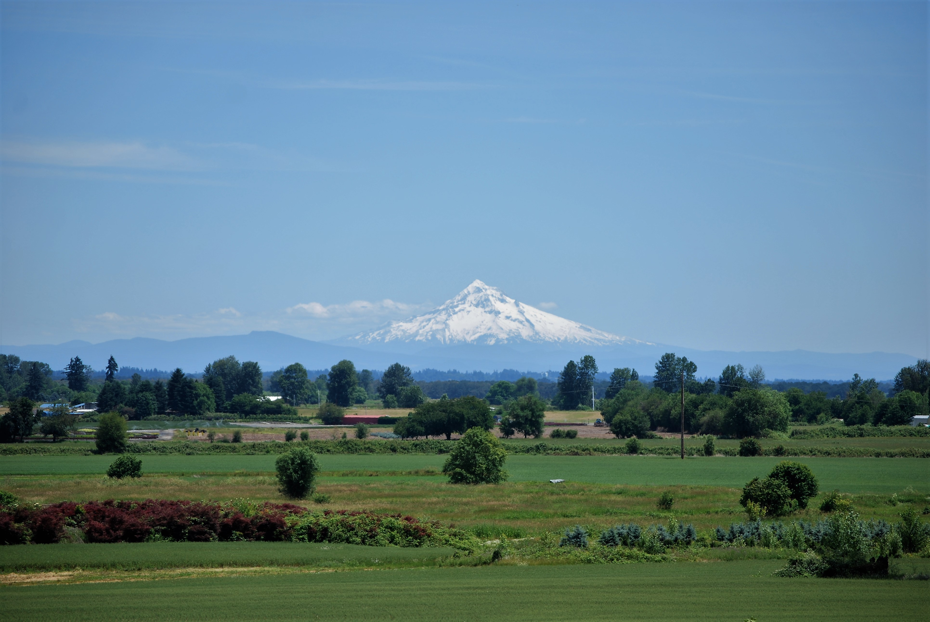
Thanks for coming!
PLEASE RETURN YOUR CLICKERS AT THE DOOR!

