Slide 1
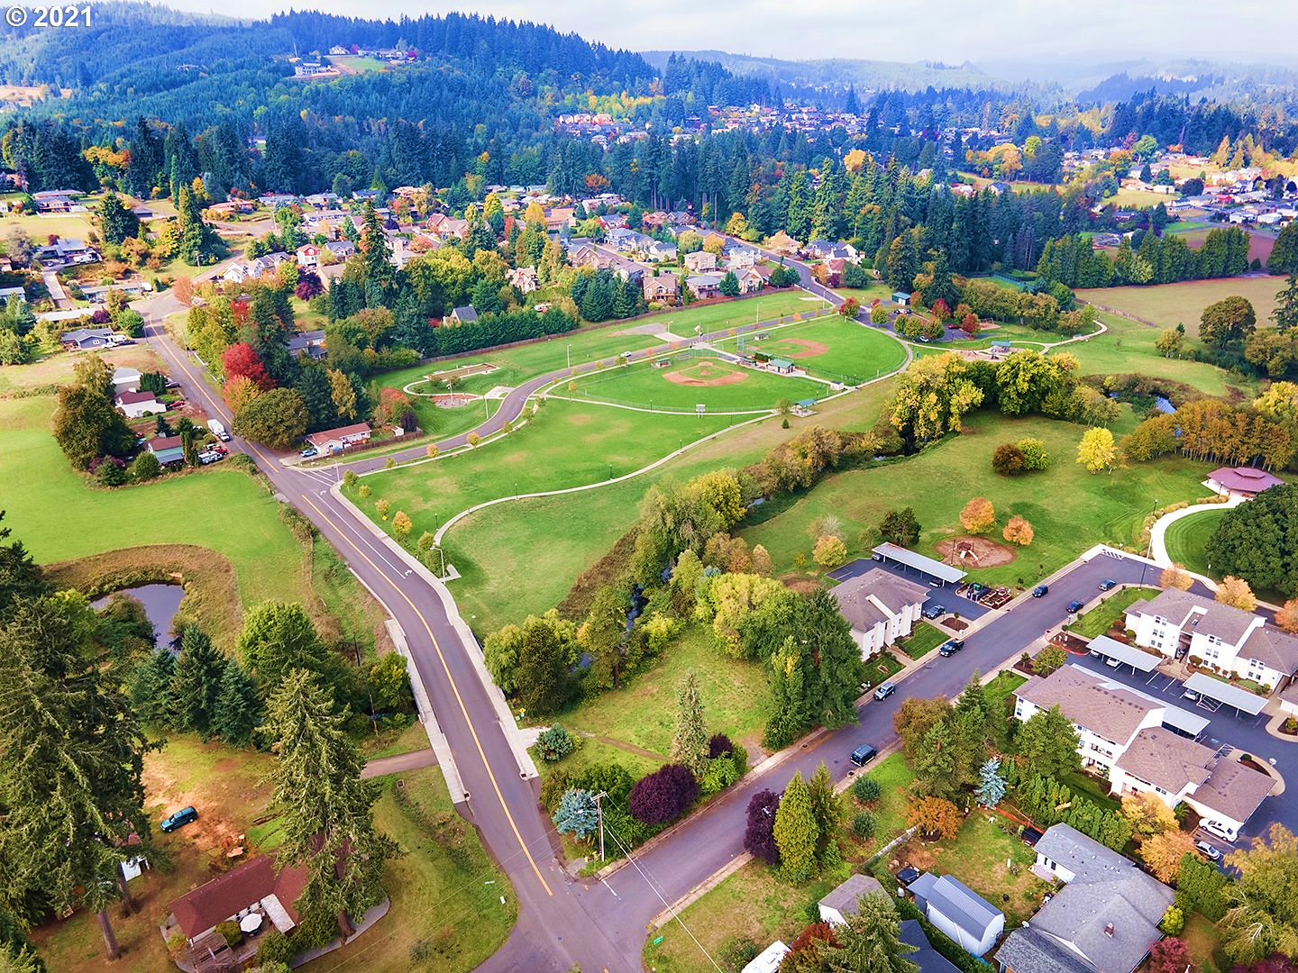
Oct 20, 2022
Scappoose Veteran’s Park

Slide 2
01
Project objectives
02
Why update the Parks Master Plan now?
Table of Content
03
Process and deliverables
04
Roles and responsibilities
05
Strengths, Weaknesses, Opportunities, Challenges
06
What’s next?

Slide 3
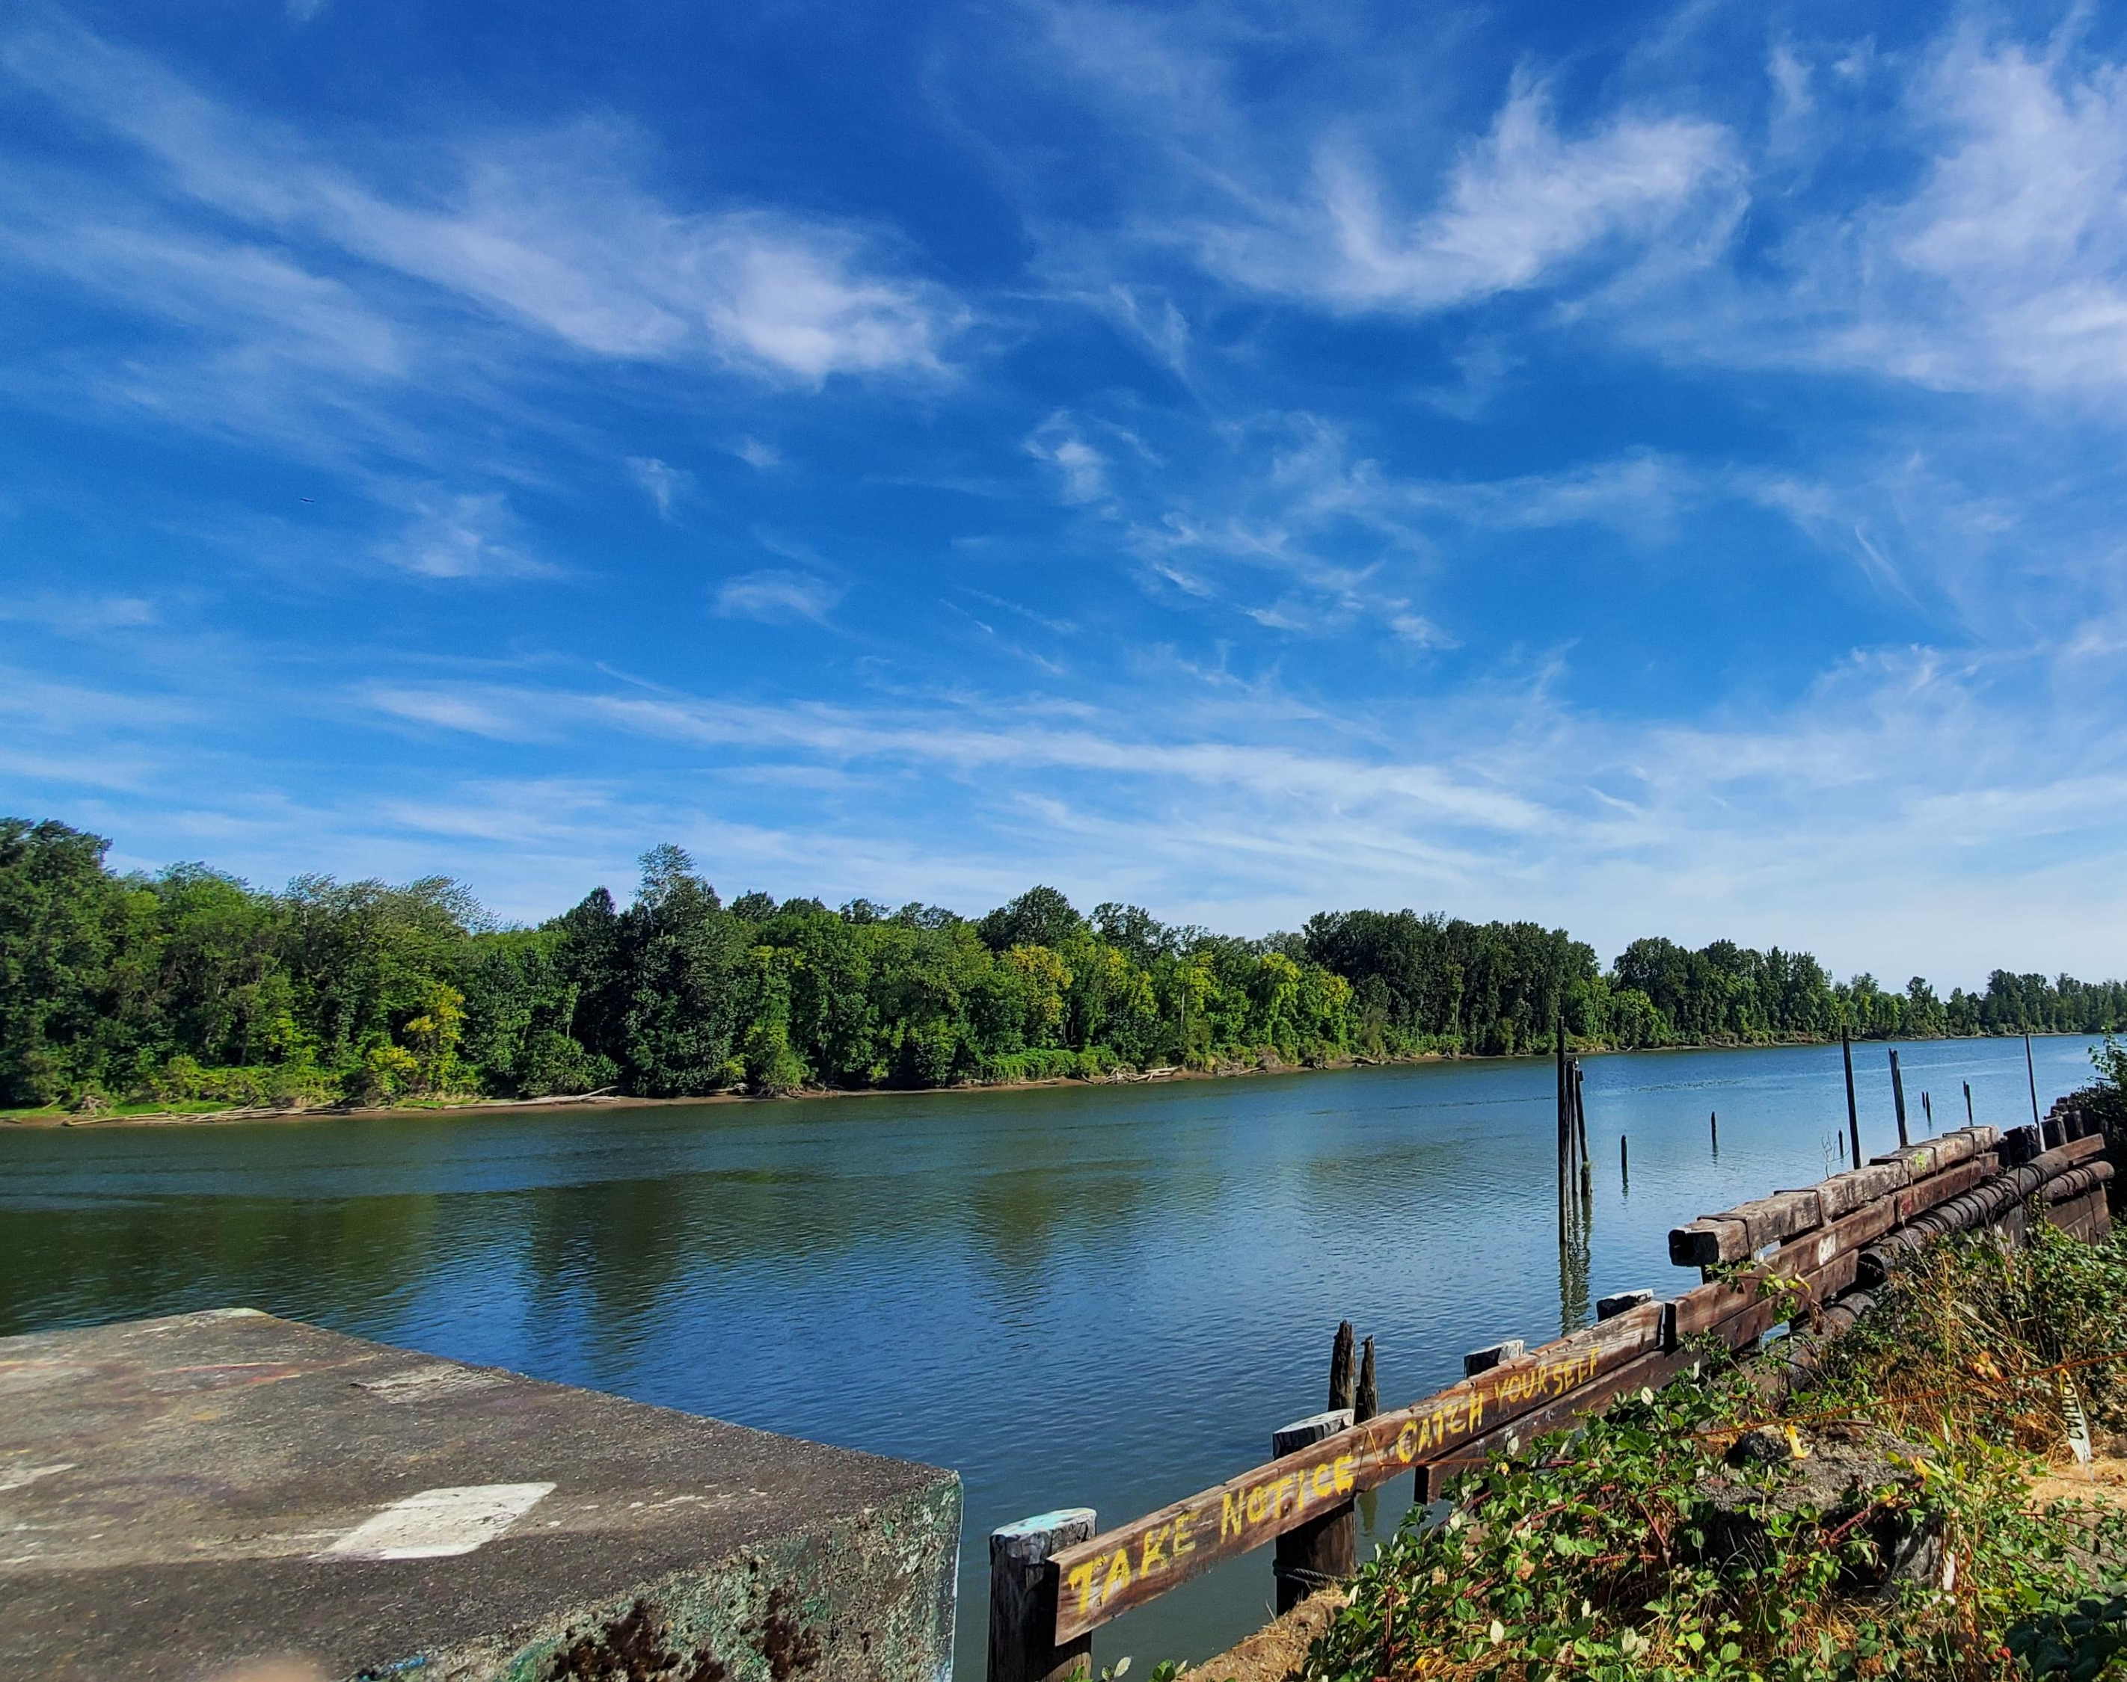
Project objectives
Look at the system holistically (vs. individual sites and projects)
Re-assess needs and create an updated, realistic investment strategy for the future
Consider competing priorities and needs to:
identify capital, operations and maintenance costs for projects
develop a implementation plan that can be phased using clear prioritization and sequencing criteria
Champman Landing

Slide 4
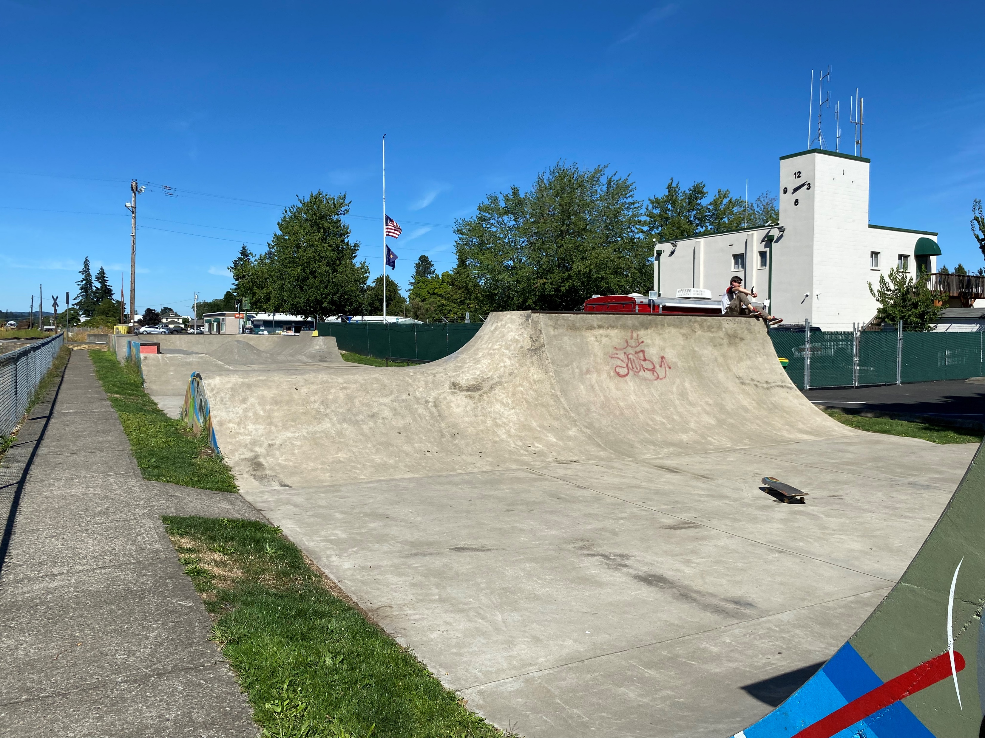
Why update the Parks Master Plan now?
Lots of identified needs, but little or no prioritization
Level of service is based on out-of-date standards/benchmarks
Walking distance to parks is not based on industry standards and may be overly-ambitious
Ranking process did not include clear criteria that matches projects with available funding
Capital costs do not reflect current costs
There is no clear understanding of the operations and maintenance costs associated with capital projects
Heritage Park

Slide 5
Process and deliverables
PHASE
01
PHASE
02
PHASE
03
PHASE
04
PHASE
05
Evaluate Existing
Conditions
Identify Needs
Update Policies & Projects
Create Action Plan
Develop & Adopt Plan
▪ Parks Tour and Condition
Assessment
▪ Public Engagement Plan
▪ System Inventory and
Mapping
▪ Strengths, Weaknesses, Opportunities, and Challenges Evaluation
▪ Existing Outreach Tools and
Results Review
▪ Online Survey
▪ Public Events
▪ Demographic and Trends
Summary
▪ Service Level Evaluation
▪ Access and Service Gap
Analysis
▪ Preliminary Vision, Goals,
and Policies
▪ Draft Comprehensive
Plan Element Update
▪ Draft Municipal Code
Update
▪ Site Strategies and
Partnership Assessment
▪ Proposed System Map
▪ Capital Improvement Plan
▪ Prioritization Criteria
▪ Funding Strategy
▪ Action and Implementation
Plan
▪ Administrative Draft Plan
▪ Final Comprehensive
Plan Element Update
▪ Final Municipal Code Update
▪ Public Draft Plan
▪ Final Master Plan
▪ SPRC Meeting #4
▪ Joint City Council and
Planning Commission
Work Session
▪ Annual Town Meeting
▪ SPRC Meeting #5
▪ Planning Commission
Hearing
▪ City Council Hearing and
Adoption
▪ SPRC Meeting #1
▪ Stakeholder Interviews
▪ “Pop-up” Events
▪ SPRC Meeting #2
▪ Joint City Council and
Planning Commission
Work Session
▪ SPRC Meeting #3
Summer - Fall 2022
Fall 2022 – Winter 2023
Winter 2023
Winter – Spring 2023
Spring - Summer 2023

Slide 6
SPRC Roles and Responsibilities
Read and be prepared to discuss any planning documents and draft reports that are provided in advance of meetings;
Engage in constructive discussion and be open to alternative strategies and points of view;
Provide high level guidance and feedback that acknowledges and draws on the diversity of opinions and outlooks represented by the Advisory Group’s constituencies;
Discuss interrelated park and recreation issues;
As requested, help promote public outreach activities to inform constituents and other community members about the Master Plan process; and
Provide direction, raise questions during meetings and work with the project team to ensure the success of the Master Plan and the planning process.

Slide 7
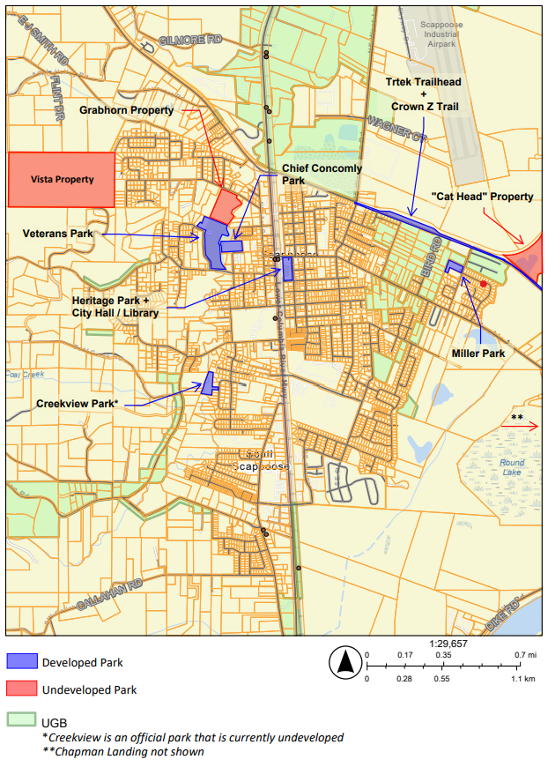
Strengths, Weaknesses, Opportunities, Challenges
Existing Park System
Developed Parks
▪ Heritage Park
▪ Veterans Park
▪ Miller Park
▪ Chief Concomly Park
▪ Creekview Park
▪ Trtek Trailhead/Crown Zellerbach (Crown Z) Trail
▪ Chapman Landing
Undeveloped Parks
▪ Vista Property
▪ Grabhorn Property
▪ Commerce (“Cat Head”) Property

Slide 8
Strengths, Weaknesses, Opportunities, Challenges
STRENGTHS
WEAKNESSES
Sites are clean and well maintained
Many sites have unique characteristics and features
Several partnerships enhance aesthetics and/or recreation opportunities
Trail corridor supports recreation and non-motorized transportation, with connections clear to Vernonia
Lack of shade
Lack of diversity in recreation options and experiences
Lack of challenge opportunities for teens and young adults
Functional issues at several sites
Access issues at several sites, including undeveloped park properties
Many recreation opportunities only available through school facilities (e.g., tennis, running track)
Lack of interconnected bike and pedestrian system

Slide 9
Strengths, Weaknesses, Opportunities, Challenges
OPPORTUNITIES
CHALLENGES
Expand uses by developing multiple City-owned park properties
Continue to coordinate with schools for public use of sports fields, sports courts, and track (at schools and at fields behind District offices where JV softball is played)
Consider school partnerships to provide synthetic turf fields
Integrate asset management program to track and replace facilities at end of lifecycles
Continue to coordinate with Watershed Council on climate resiliency and natural resource protection
Extensive amount of undeveloped parkland (and cost to maintain and improve)
Prioritizing investments when multiple improvements are needed
Event spaces in the City all have constraints
There are few recreational facilities in the south of the City and no parks in the southeast
If a specialized facility such as a pool or recreation or community center is desired a new site will be needed, ideally located along a main arterial for access.

Slide 10
Positive outcomes of our work would include…
The hurdles to achieving desired outcomes may be….
…
…
…
…
…
…
…
…

Slide 11
What’s next ?
Public Events
Stakeholder and small group interviews
Online Survey
Pop-up events
Watts House Spirit Tasting, 10/28, 6-8 PM
Library Event in November?
TAC #2 (11/17/22)
City Council and Planning Commission Joint Work Session #1 (11/21/22)

