Slide 1
Presented to City Council on March 15, 2021
City of Scappoose
Street Fund Budget & Project Update

Slide 2
Agenda
Funding Sources
2020-21 Streets Budget
Sidewalk Program
Project Status
Proposed Plan
Questions / Discussion

Slide 3
Funding Sources for Streets
Interest Earned
Inspection Fees
State Fuel Tax
Local Fuel Tax
Surface Transportation Funds
**Note – Streets are not funded by Property Taxes

Slide 4
Federal Gas Tax
A.K.A. - Surface Transportation Fund
Can only be used for ODOT approved capital* projects
City receives approximately $75,000 per year into this Fund
Current balance of $517,756+/-
City is building the fund in plans of larger paving projects
*What is a capital project? The City of Scappoose recognizes “capital” as an investment into its assets or infrastructure that exceeds $5,000

Slide 5
2020-21 Streets Budget
Revenue
State Gas Tax $568,155
Local Gas Tax $250,000
Misc. Income $36,000
$854,155 (not including STP Funds)
Expenses
Personnel Services $301,659
Materials and Services $233,454
Capital / Equipment $250,000
Contingency $69,042
$854,155
Surface Trans. Prog. (STP) $517,756
Total $1,371,911
*Note: This is not the complete budget, some numbers are estimated projections

Slide 6
Sidewalk Program
Program launched in March of 2020
City has received 8 applications
5 applications have been accepted and completed
3 of the applications are pending
City continues to receive periodic inquiries into Program

Slide 7
Street & Sidewalk Projects
Completed
Sidewalk repairs along Highway 30
ADA ramp replacement along SE 6th
Sidewalk infill along SE 6th
Planned
Continue Annual Crack Sealing
Old Portland Road Sidewalk Infill (plans complete)
SE 3rd Place Sidewalk Construction (plans at 10%)
SE Vine St. Sidewalk Construction (plans at 10%)
ADA Ramp Replacement (City-wide in phases)
Pavement Overlays (begin in NW portion of City after utility repairs)
Partnerships with Development

Slide 8
Proposed Plan
Continue to accrue STP Funds for larger projects
Continue to offer and promote Sidewalk Program
Continue with Streetlight Improvements
Move forward with Old Portland Road Project in phases (2-3 phases)
Pursue alternative funding sources for School Zone Projects
Partner with development when possible
Dedicate $200,000 of Local Fuel Tax revenue to sidewalks annually

Slide 9
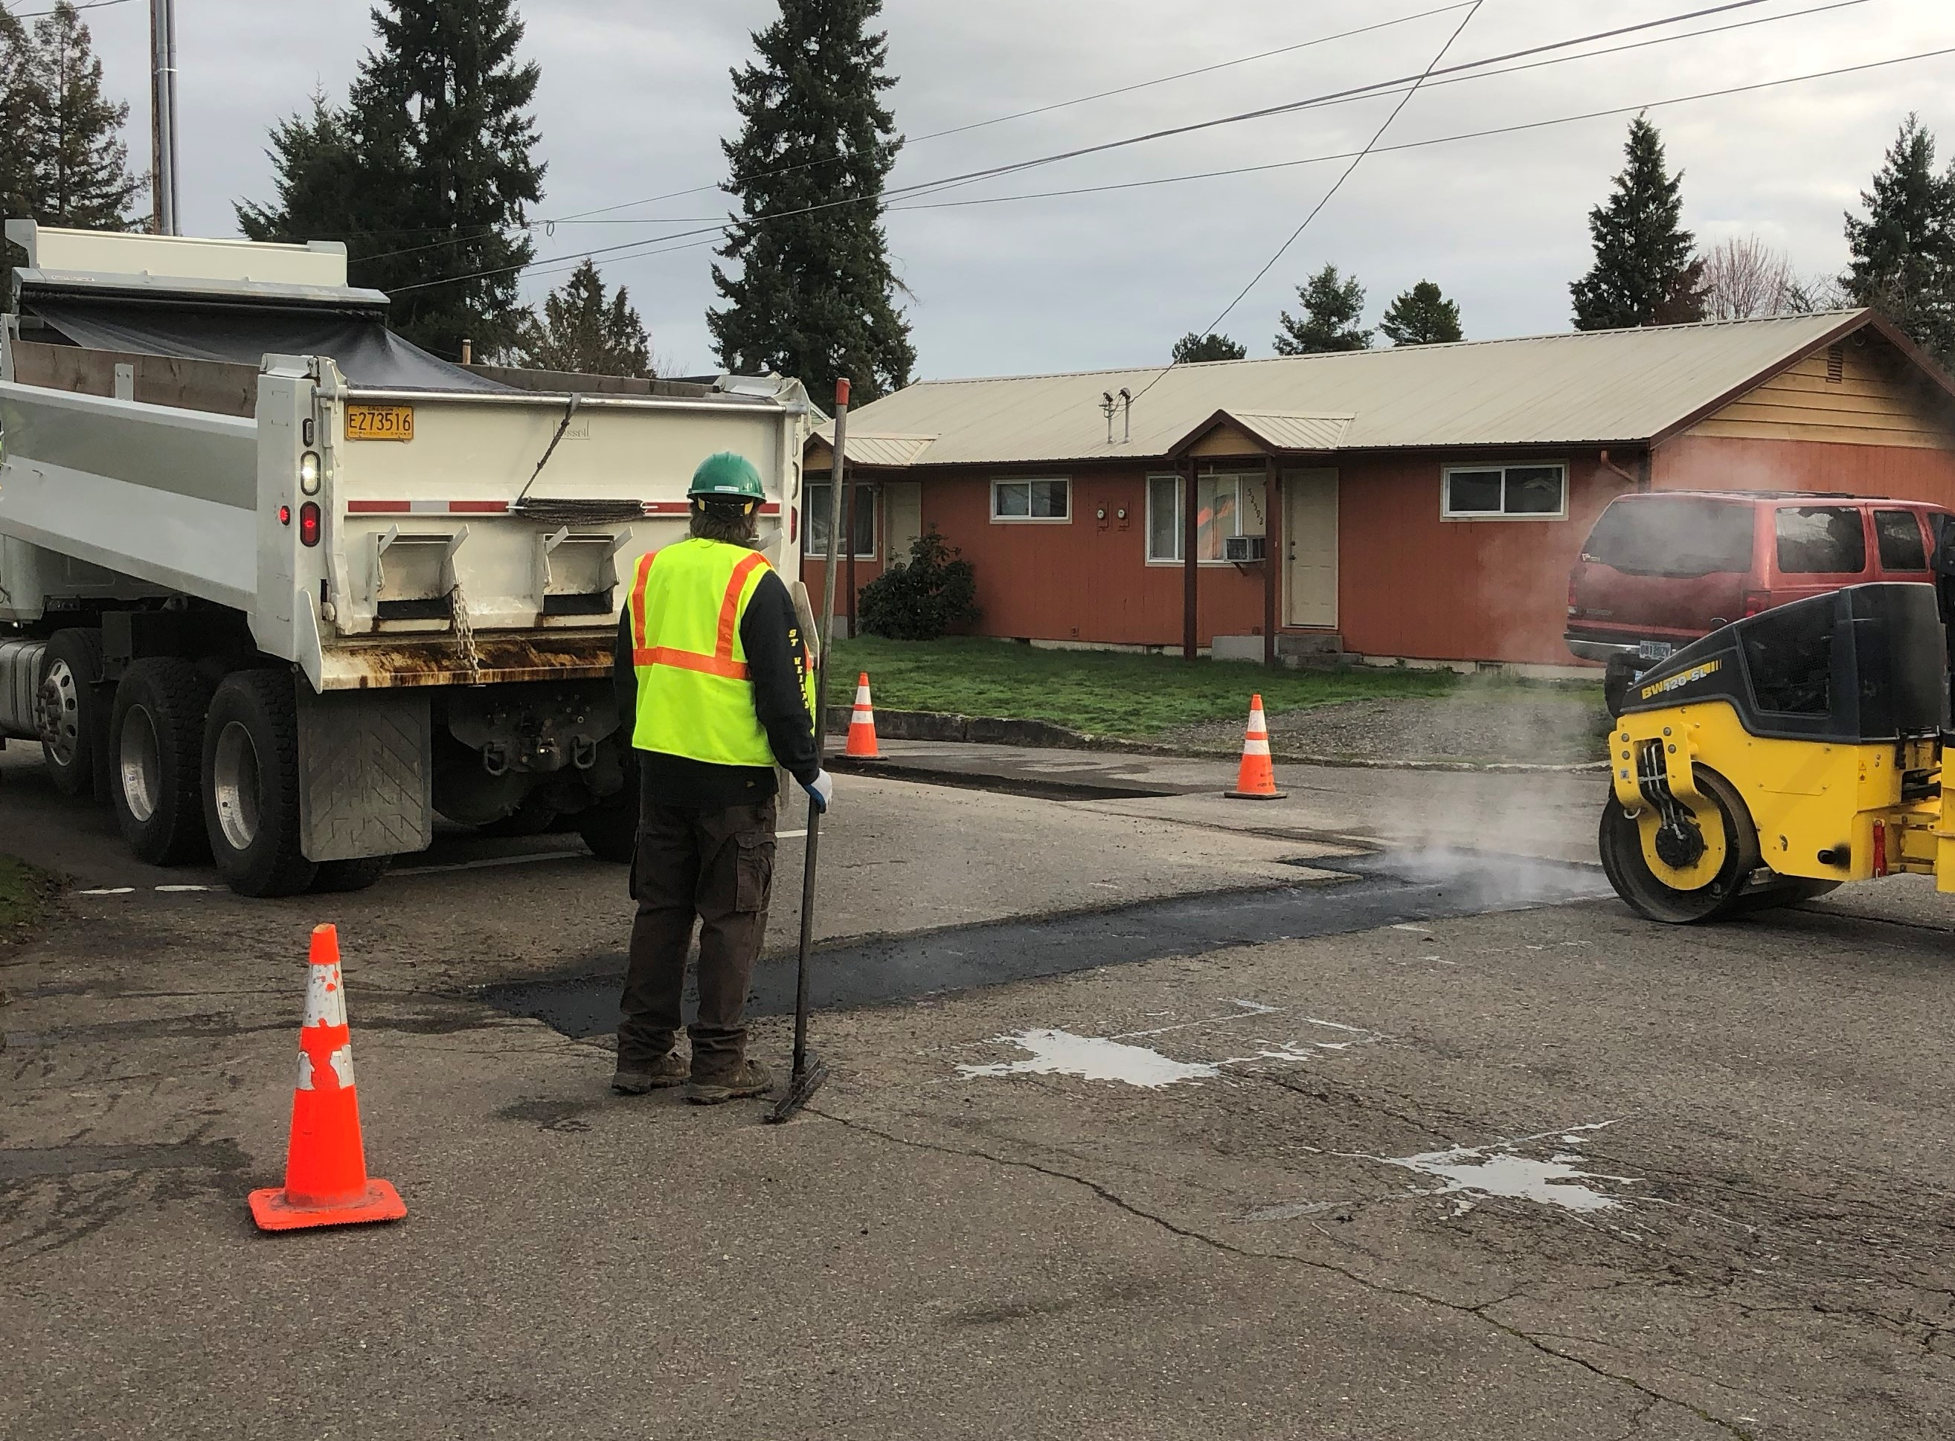
Questions?
z

